Slide 1


Slide 2
2016-2017
Cortland Enlarged City School District

Slide 3
2017-2018
Budget Message

Slide 4
Budget Message
We remain committed to preparing “world-ready” graduates.
Preserve the opportunities we have now for children: We will continue our current efforts to provide a well-rounded educational experience for our students in a safe environment.
Responsibly expand course offerings and opportunities: Our teachers and administrators are proposing new courses as opportunities arise. We are committed to offering relevant and engaging courses so that our students are prepared for their future.
Keep cuts away from students: Our goal is to make any necessary reductions in force through attrition and to cut other expenses that do not directly affect students.

Slide 5
Budget Message
The fiscal challenges are very real.
Legacy costs continue to go up: Health care and retiree benefits (over which we have no control) continue to increase in rates that far exceed inflation or any increase in State Aid.
Albany has not fulfilled its obligations to the taxpayers: Albany took $7.7 million from Cortland taxpayers over the course of six years with the Gap Elimination Adjustment and is behind $3.3 million in court-ordered foundation aid.
We must stop depleting our reserves to balance the budget: The use of reserves is not healthy for the district. Our savings accounts will run out in the next year or two.

Slide 6
Budget Message
We’re building a budget for next year and beyond.
We must continue to take care of our facilities: The Board of Education has commissioned a study to explore more efficient ways to utilize our existing buildings as well as maximize the educational opportunities for students.
We must contain legacy costs: Costs for retirement systems and health care are out of our direct control. We will continue to work with our bargaining units to contain costs. Many retirees are living longer than they worked with the district.
We must continue to keep “students first:” Our students expect and deserve a quality, “world ready” education. Our decisions must always be based on their best interest.

Slide 7
2016-2017
Our Continuous Improvement Journey

Slide 8
Our Challenge
Our 3-8 achievement is not what we want it to be
Our graduation rate is not what we want it to be
There are gaps between the achievement of different groups of learners in our district
Levels of student engagement are not what we want them to be
Our students are not as healthy as we want them to be
Our community has high expectations

Slide 9
The Good News
We believe that our students deserve our best work
We have talented and enthusiastic teachers
We have the necessary resources
Our community is supportive of our efforts to improve
We have a supportive Board of Education

Slide 10
We Have a Plan
There are six components.
The first two address goals and process.
The other four are actionable goals.
1
2
3
4
5
6

Slide 11
Theory of Action
GOAL: A deliberate plan of action to lead the district.
1
2
3
4
5
6

Slide 12
Theory of Action
UPDATE: We remain committed to the plan for implementation of Tenets 3-6.
1
2
3
4
5
6

Slide 13
SMART Goals
GOAL: Measurable goals that guide district actions. Plans will be monitored and adapted.
1
2
3
4
5
6

Slide 14
SMART Goals
UPDATE: Smart goals are guiding the district and building improvement work.
1
2
3
4
5
6

Slide 15
Guaranteed and Viable Curriculum
GOAL: Identify essential learning so that we ensure that all students will learn via the teaching-learning cycle.
1
2
3
4
5
6

Slide 16
Guaranteed and Viable Curriculum
UPDATE: Essentials have been identified, pacing guides made, common assessments have been administered for today’s analysis and planning.
Use of the teaching-learning cycle will continue.
Common planning time was introduced and will be expanded (built into schedules).
1
2
3
4
5
6

Slide 17
Curriculum Archive
From the C&I webpage
To shared folder system
Migrate currently used curricula and curriculum resources to the shared folders
Move from Lotus database
Move from H drive
Physical storage will be purged

Slide 18
Engaging Instruction
GOAL: Instruction will be engaging and students will be involved in their learning.
1
2
3
4
5
6

Slide 19
Engaging Instruction
UPDATE: A district-wide definition is under development. District and building leadership teams are working to foster a common understanding of engagement across the district.
Engagement | Strategic Compliance | Ritual Compliance | Retreatism | Rebellion
1
2
3
4
5
6

Slide 20
Engaging Instruction
Engagement | Strategic Compliance | Ritual Compliance | Retreatism | Rebellion
Rebellion
Refuses to comply
No persistence
Sabotage self, others, and class
Cheat
Build negative coalitions

Slide 21
Engaging Instruction
Engagement | Strategic Compliance | Ritual Compliance | Retreatism | Rebellion
Retreatism
Does not attend
Head down
Vacant stare
Sleep
No persistence
When pushed can rebel

Slide 22
Engaging Instruction
Engagement | Strategic Compliance | Ritual Compliance | Retreatism | Rebellion
Ritual Compliance
Minimal attention
Minimal effort
Easily distracted
Easily discouraged
Does work primarily when supervised
Avoids a negative consequence

Slide 23
Engaging Instruction
Engagement | Strategic Compliance | Ritual Compliance | Retreatism | Rebellion
Strategic Compliance
Works for external reward
Works for some later goal
Persists up to the point when the external criterion is satisfied
Pays attention

Slide 24
Engaging Instruction
Engagement | Strategic Compliance | Ritual Compliance | Retreatism | Rebellion
Engagement
Finds meaning and value in the task and learning
Persists
Is committed
Volunteers extra time, attention, effort to do things to a high standard

Slide 25

Engaging Instruction
Engagement | Strategic Compliance | Ritual Compliance | Retreatism | Rebellion
?

Slide 26

Engaging Instruction
Engagement | Strategic Compliance | Ritual Compliance | Retreatism | Rebellion

Slide 27
Engaging Instruction
In the future (this year and next):
What are the ingredients of engagement?
What school and classroom conditions promote engagement?
How do we plan for engagement?
How do we know students are engaged?
1
2
3
4
5
6

Slide 28
Social Emotional Health
GOAL: Coordinated systems to support the social, emotional, physical, and academic well-being of all our students.
1
2
3
4
5
6

Slide 29
Social Emotional Health
UPDATE: Drafts of three core competencies have been developed. Once finalized, they will guide decisions.
Develop self-awareness and self-management skills to achieve school and life success.
Use social-awareness and interpersonal skills to establish and maintain positive relationships.
Demonstrate decision-making skills and responsible behaviors.
1
2
3
4
5
6

Slide 30
Community Engagement and Communication
GOAL: The educational community is aware of and involved in district and school continuous improvement efforts.
1
2
3
4
5
6

Slide 31
Community Engagement and Communication
UPDATE: Communications committee has been formed.
A communications plan for the district is under development.
Results from latest community survey just arrived.
1
2
3
4
5
6

Slide 32
Communication
Monday Message
  Instructional messages
  Technical messages
  PD messages
  Functional messages
Payday! Active Learning Strategies
  Give ‘em a try!
  Make suggestions
Social media prep for next year

Slide 33
cortlandschools.org
We have a new look
Many old and dead pages have been purged
It is ALWAYS a work in progress
The key is to maintain the content

Slide 34
SchoolTool
The move was inevitable
Saving $100 K by doing it now
July 1 “live”
Training
  Support staff and admins now & summer
  Teachers September 6th & November 10th

Slide 35
Guaranteed and Viable Curriculum
GOAL: Identify essential learning so that we ensure that all students will learn via the teaching-learning cycle.
1
2
3
4
5
6

Slide 36
The G&V Work
Identify essential standards
Break the standards down into manageable skills and understandings
Translate into learning targets
Develop common formative assessments for learning targets
Look at student work on the common formative assessments
Make individual and team instructional decisions

Slide 37


Slide 38
The G&V Work
Identify essential standards
Break the standards down into manageable skills and understandings
Translate into learning targets
Develop common formative assessments for learning targets
Look at student work on the common formative assessments
Make individual and team instructional decisions

Slide 39
October 7th Work
Identify essential standards
Break the standards down into manageable skills and understandings
Translate into learning targets
Develop common formative assessments for learning targets
Look at student work on the common formative assessments
Make individual and team instructional decisions

Slide 40
Since October 7th
Identify essential standards
Break the standards down into manageable skills and understandings
Translate into learning targets
Develop common formative assessments for learning targets
Look at student work on the common formative assessments
Make individual and team instructional decisions

Slide 41
Today’s Work
Identify essential standards
Break the standards down into manageable skills and understandings
Translate into learning targets
Develop common formative assessments for learning targets
Look at student work on the common formative assessments
Make individual and team instructional decisions

Slide 42
Learning Targets
I can explain why the teaching-learning cycle is important.
I can look at student work to identify patterns of understanding, misunderstanding, and lack of understanding
I can plan instructional responses based on the student work
I can work interdependently with my team of teachers to achieve these goals

Slide 43
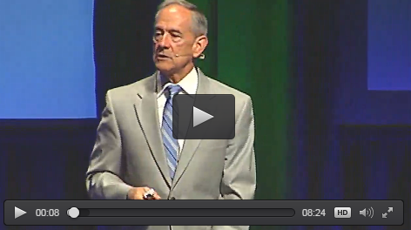
Why Common Assessment?

Slide 44
Our Goal
To create a systematic process that ensures every child receives additional time and support needed to learn at high levels…
So that our students are “world-ready.”
Notes:
From “Creating a Culture of Collective Responsibility: From Believing to Doing” as delivered by Austin Buffum.

Slide 45
The Mission
To ensure high levels of learning for all students.
High levels means:
High school plus
Grade-level or better
Ready for whatever comes next
Notes:
From “Simplifying Response to Intervention: Four Essential Guiding Principles” as delivered by Luis Cruz.

Slide 46
Fundamental Assumptions
Not all students learn in the same way.
Not all students learn at the same speed.
Some students lack prior knowledge and skills.
Some students lack proper behaviors.
Some students have a home life that is counterproductive to academic success.
Notes:
From “Simplifying Response to Intervention: Four Essential Guiding Principles” as delivered by Luis Cruz.

Slide 47
“Creating a collaborative culture is the single most important factor for successful school improvement initiatives and the first order of business for those seeking to enhance the effectiveness of their schools.”
-Eastwood & Lewis. (2002).
Restructuring that lasts: Managing the performance gap. Journal of School Leadership.
Notes:
From “Digging Deeper Into the RTI at Work Pyramid: Creating Collaborative Teams” as delivered by Mike Mattos.

Slide 48
Collective Responsibility
Two fundamental beliefs:
We, as educators, accept responsibility to ensure high levels of learning for every child
We assume all students can learn at high levels
Notes:
From “Putting It All Together: Creating a Multitiered System of Supports - Secondary” as delivered by Mike Mattos & Luiz Cruz.

Slide 49
The “Right Work”
Essential Learning (Targets)
Instructional Response (Intervention)
Assessment Evidence
Prioritize standards; identify the essentials
Unwrap standards to identify learning targets
Plan assessment evidence from learning targets and standards
Understand rigor and item design
Administer common assessments
Plan instructional response based on student work
Involve students in the process
Notes:
From “Putting It All Together: Linking Instruction, Assessment, and Intervention” as delivered by Nicole Dimich Vagle.

Slide 50
Essentials
Essential Standards:
A subset of the entire list of state content and performance standards
Priority standards that are essential for student understanding and success
The standards that every teacher makes sure that every student learns prior to leaving the current grade
The focus of instructional and assessment time and energy (including interventions and remediation)
Notes:
From “Putting It All Together: Linking Instruction, Assessment, and Intervention” as delivered by Nicole Dimich Vagle.

Slide 51
Essentials
Essential Standards have:
Endurance (is important beyond a particular grade or course)
Leverage (crosses disciplinary boundaries)
Readiness (needed for the next level of learning)
-Reeves. (2002).
The Leader’s Guide to Standards: A Blueprint for Educational Equity and Excellence
Notes:
From “Putting It All Together: Linking Instruction, Assessment, and Intervention” as delivered by Nicole Dimich Vagle.

Slide 52
Essentials
Essential Standards:
Which standards are essential at each grade level and course?
Which standards have endurance, leverage, and readiness?
Which standards have our students failed to master on state assessments?
Notes:
From “Putting It All Together: Linking Instruction, Assessment, and Intervention” as delivered by Nicole Dimich Vagle.

Slide 53
Essentials
Four Steps:
Use criteria to filter individually
Develop a draft consensus list
Compare with data and test blueprints
Review for vertical alignment
Notes:
From “Putting It All Together: Linking Instruction, Assessment, and Intervention” as delivered by Nicole Dimich Vagle.

Slide 54
Unpacking (unwrapping)
For each essential standard:
Focus on the key words
Identify skills & knowledge
Identify academic & technical vocabulary
Identify level of rigor
Identify big ideas behind the standard
Identify essential and guiding questions
Notes:
From “Putting It All Together: Linking Instruction, Assessment, and Intervention” as delivered by Nicole Dimich Vagle.

Slide 55
Guaranteed & Viable
To get to a guaranteed and viable curriculum, we use the teaching-learning cycle and these steps:
Identifying essentials
Agenda for identifying essentials
Agenda for unpacking/unwrapping (organizer)
Agenda for developing "I Can" statements
Common formative assessment development
Protocol identification/selection/preparation
Looking at student work
Making instructional and curriculum decisions
Notes:
From “Simplifying Response to Intervention: Four Essential Guiding Principles” as delivered by Luis Cruz.

Slide 56
Our Timeline
2016-2017:
Q1: Essentials and Learning Targets
Q2: Common Formative Assessments
Q3: Teaching Learning Cycle
Q4: Teaching Learning Cycle
All courses 7-12, math K-2,
math & ELA 3-6
Notes:
From “Simplifying Response to Intervention: Four Essential Guiding Principles” as delivered by Luis Cruz.

Slide 57
Our Timeline
2017-2018 (year 2 courses):
Q1: Essentials and Learning Targets
Q2: Common Formative Assessments
Q3: Teaching Learning Cycle
Q4: Teaching Learning Cycle
Year 1 (courses 7-12, math K-2, math & ELA 3-6) continue with at least one “Cycle”
each Q
Notes:
From “Simplifying Response to Intervention: Four Essential Guiding Principles” as delivered by Luis Cruz.

Slide 58
Teaching Learning Cycle
Classroom
Instruction
Common
Formative
Assessment
Look at Student Work
Instructional
Decisions
Essential
Standards
Notes:
From “Simplifying Response to Intervention: Four Essential Guiding Principles” as delivered by Luis Cruz.

Slide 59
Looking at Student Work
Using the 3A protocol:
  Analysis
  Action
  Assessment
The 3A protocol is a scaffold
  The sheet is not the point
  Filling out boxes is not the point
  It’s a scaffold until it’s cultural

Slide 60
Looking at Student Work
It’s part of a cultural shift: We want the Teaching-Learning Cycle to be our standard operating procedure – not a special event.
It might feel like it’s another thing that we have to do.
We want to get to the point that it’s just our culture.

Slide 61
Looking at Student Work
Typically this work is done in teacher teams, at the school level.
  2nd grade ELA at Parker
  4th grade math at Smith
  7th grade ELA teachers at the Junior High
  New Media ART teachers at the High School
Interventionists and special educators as involved as appropriate

Slide 62
Looking at Student Work
Step 1 (5 minutes)
Remind each other of the essentials/learning targets that are being addressed in the common formative assessment. Team members examine their own students’ work in silence, jotting down notes of their observations.

Slide 63
Looking at Student Work
Step 1
Remind each other of the essentials/learning targets that are being addressed in the common formative assessment. Team members examine their own students’ work in silence, jotting down notes of their observations.

Slide 64
Looking at Student Work
Step 2
Team identifies patterns that emerge (group discussion). Look for the concepts that seem to have been established and those that have not been established. What are the common errors? What are the common misunderstandings?

Slide 65
Looking at Student Work
Step 3
Sort student responses according to the patterns that were identified in the previous step. Recorder records information in the 3A template.

Slide 66
Looking at Student Work
Step 4
Discuss the implications for teaching. Also look at patterns in responses by teacher, potentially identifying team members who have an effective strategy that could be used during the intervention.

Slide 67
Looking at Student Work
Step 5
Make a plan of action for each of the groups of students. Include information about what the intervention will be, who will provide it, and when/for how long it will be provided. Also identify the follow-up assessment measure to gauge the impact of the instructional response/intervention. Before the meeting ends, make plans for the next meeting.

Slide 68
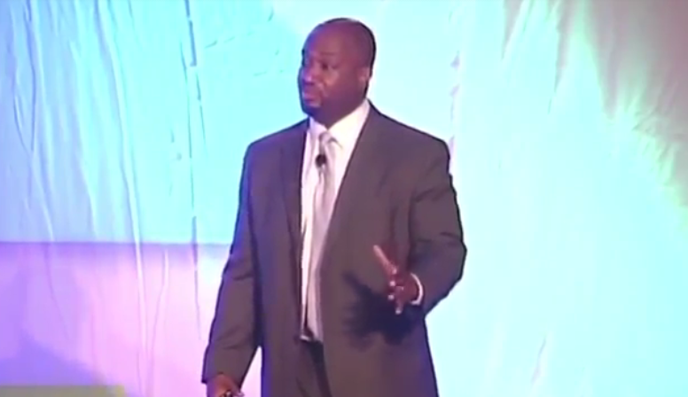
Reflecting on Student Work

Slide 69
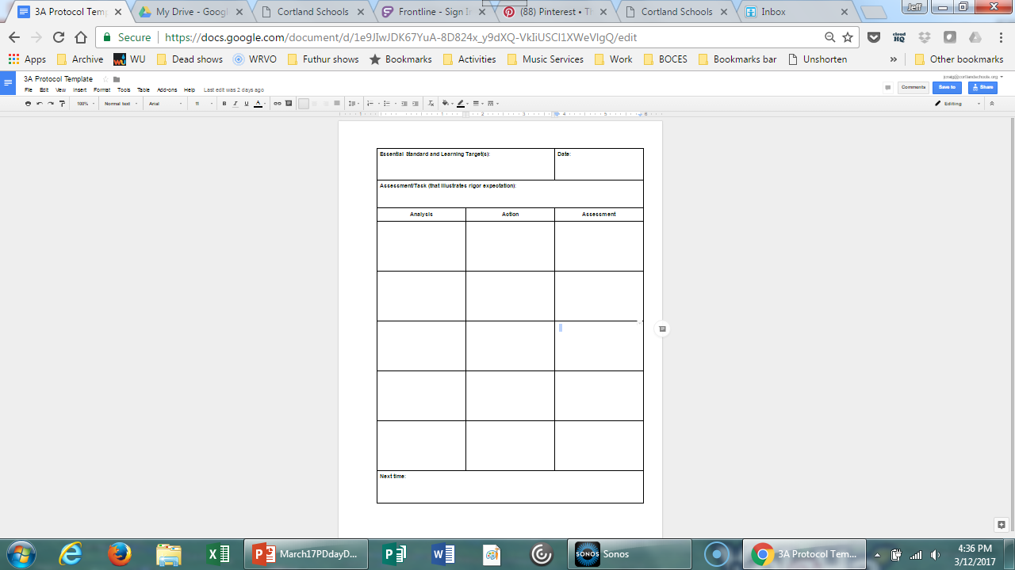
Looking at Student Work

Slide 70
Looking at Student Work

Slide 71
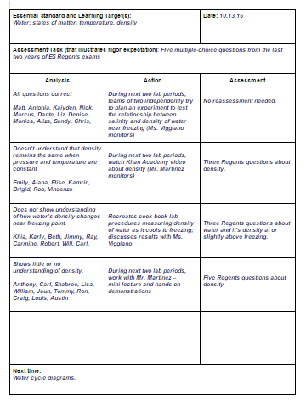
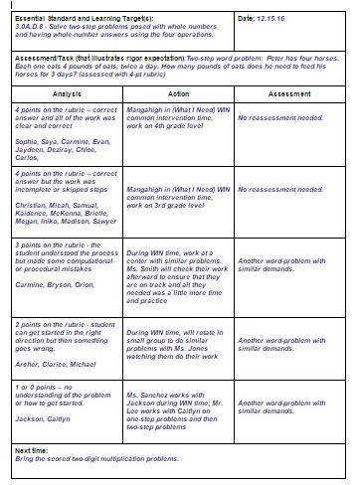
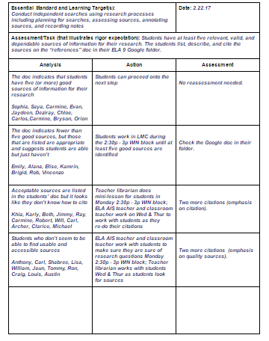
Looking at Student Work

Slide 72
Our Timeline
2016-2017:
Q1: Essentials and Learning Targets
Q2: Common Formative Assessments
Q3: Teaching Learning Cycle
Q4: Teaching Learning Cycle
All courses 7-12, math K-2,
math & ELA 3-6
Notes:
From “Simplifying Response to Intervention: Four Essential Guiding Principles” as delivered by Luis Cruz.

Slide 73
Our Timeline
2017-2018 (year 2 courses):
Q1: Essentials and Learning Targets
Q2: Common Formative Assessments
Q3: Teaching Learning Cycle
Q4: Teaching Learning Cycle
Year 1 (courses 7-12, math K-2, math & ELA 3-6) continue with at least one “Cycle”
each Q
Notes:
From “Simplifying Response to Intervention: Four Essential Guiding Principles” as delivered by Luis Cruz.

Slide 74
Looking at Student Work
The 3A protocol is a scaffold
  The sheet is not the point
  Filling out boxes is not the point
  It’s a scaffold until it’s cultural

Slide 75
Looking at Student Work
It’s part of a cultural shift: We want the Teaching-Learning Cycle to be our standard operating procedure – not a special event.
It might feel like it’s another thing that we have to do.
We want to get to the point that it’s just our culture – JUST WHAT WE DO.

Slide 76
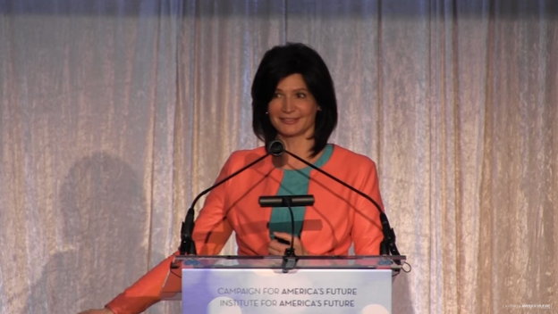
What We Do
Notes:
https://www.youtube.com/watch?v=2zMbspRhqJc

Slide 77
What We Do
Today
Teaching-Learning Cycle with the student work we brought
Prepare for the next cycle, and/or
Continue Essentials>Unpacking>Learning Targets work
Migrate material to shared folders
K-8 ELA and math will gather back in aud. after lunch to talk about module exams

Slide 78
#WEARECORTLAND

