Slide 1


Slide 2
2016-2017
Cortland Enlarged City School District

Slide 3
2016-2017
Our Continuous Improvement Journey

Slide 4
2016-2017
Common Formative Assessment

Slide 5
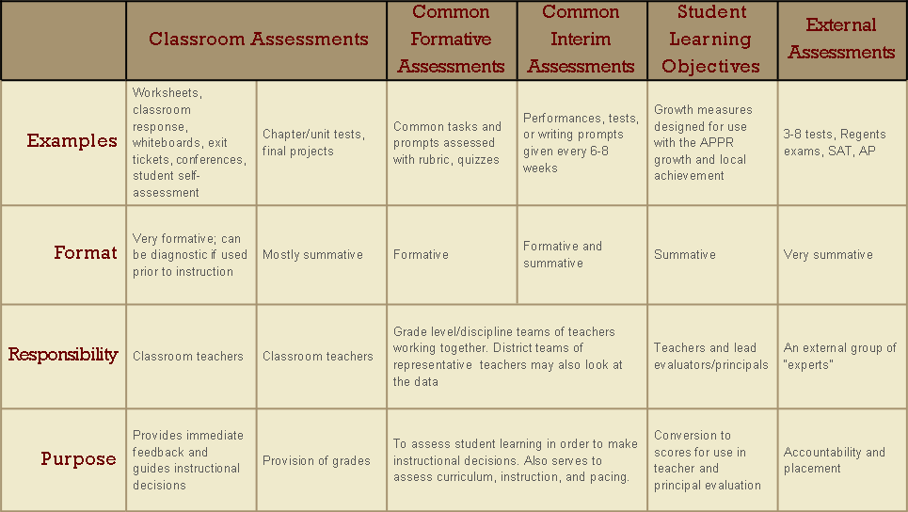
Balanced Assessment System

Slide 6
The “Right Work”
Essential Learning (Targets)
Instructional Response (Intervention)
Assessment Evidence
Prioritize standards; identify the essential
Unwrap standards to identify learning targets
Plan assessment evidence from learning targets and standards
Understand rigor and item design
Administer common assessments
Plan instructional response based on student work
Involve students in the process
Notes:
From “Putting It All Together: Linking Instruction, Assessment, and Intervention” as delivered by Nicole Dimich Vagle.

Slide 7
Getting Ready
For our first effort:
Consult pacing guide to identify which essentials will be the focus of early to mid March (we will be using the assessment results on March 17th)
Go one layer deeper to identify the learning targets with the essentials in early to mid March

Slide 8
Getting Ready
List the learning targets for early March:
Learning Target | Assessment Possibilities

Slide 9
Getting Ready
Brainstorm ways to assess the targets:
Learning Target | Assessment Possibilities

Slide 10
Getting Ready
Choose the best assessment approaches:
Learning Target | Assessment Strategies

Slide 11
Getting Ready
Construct the assessment item(s):
Less can be more
Thinks about levels of Blooms (or DOK)
Item(s) should be able to show understanding as well as possible misunderstandings and common errors
Seek efficiency or “most bang for the buck”

Slide 12
Getting Ready
Construct the assessment item(s):
Try them out
Make any necessary adjustments
Calendar the assessment
Decide whether it needs to be scored in advance or on March 17 (if it needs to be scored at all)

Slide 13
After the Assessment
Look at student work (usually according to a simple protocol)
Examine patterns in the data to identify effective approaches
Examine the data for student-specific information
Collaboratively plan interventions (that might be individual or collective)

