Slide 1


Slide 2
2016-2017
Cortland Enlarged City School District

Slide 3
2016-2017
Our Continuous Improvement Journey

Slide 4
2016-2017
Assessment

Slide 5
The “Right Work”
“To begin with the end in mind means to start with a clear understanding of your destination. It means to know where you’re going so that you better understand where you are now so that the steps you take are always in the right direction.”
-Covey. (1994).
The Seven Habits of Highly Effective People:
Powerful Lessons in Personal Change
Notes:
From “Putting It All Together: Linking Instruction, Assessment, and Intervention” as delivered by Nicole Dimich Vagle.

Slide 6
The “Right Work”
Essential Learning (Targets)
Instructional Response (Intervention)
Assessment Evidence
Prioritize standards; identify the essential
Unwrap standards to identify learning targets
Plan assessment evidence from learning targets and standards
Understand rigor and item design
Administer common assessments
Plan instructional response based on student work
Involve students in the process
Notes:
From “Putting It All Together: Linking Instruction, Assessment, and Intervention” as delivered by Nicole Dimich Vagle.

Slide 7
Assessment
Learning Targets:
Are posted on walls
Are referenced and rephrased often during class
Are reflected upon by students from beginning to middle to end
Are phrased as “I can” statements
Notes:
From “Putting It All Together: Linking Instruction, Assessment, and Intervention” as delivered by Nicole Dimich Vagle.

Slide 8
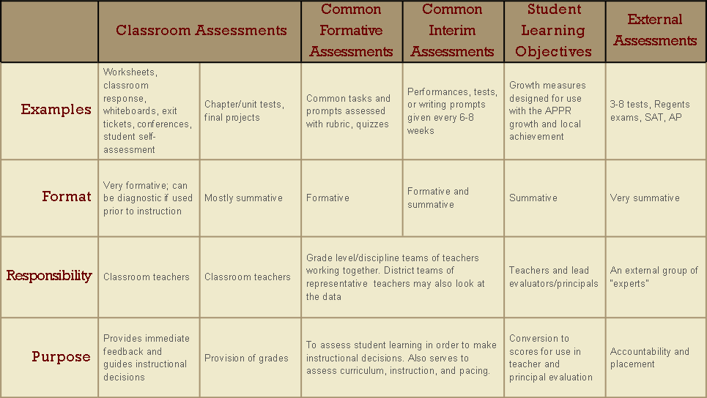
Balanced Assessment System

Slide 9
Assessment
Common Assessments:
Provide formative information about progress toward learning targets and standards
Are designed to be efficient
Can be generated by teacher teams or school/grade representatives

Slide 10
Common Assessment
“Common assessment means student learning will be assessed using the same instrument or process and according to the same criteria.”
-DuFour, DuFour, Eaker & Many. (2010).
Learning by Doing.
Notes:
From “Putting It All Together: Linking Instruction, Assessment, and Intervention” as delivered by Nicole Dimich Vagle.

Slide 11
Common Assessment
“Not standardized tests, but rather teacher-created, teacher-owned assessments that are collaboratively scored and that provide immediate feedback to students and teachers.”
-Reeves. (2010).
Notes:
From “Putting It All Together: Linking Instruction, Assessment, and Intervention” as delivered by Nicole Dimich Vagle.

Slide 12
Formative Assessment
“…Assessment functions formatively when the evidence of student learning is used to improve and inform the instructional decisions that are made by teachers, learners, and peers to improve outcomes for students.”
-Wiliam. (2011).
Embedded Formative Assessment.
Notes:
From “Putting It All Together: Linking Instruction, Assessment, and Intervention” as delivered by Nicole Dimich Vagle.

Slide 13
Formative Assessment
“Assessment for learning [formative assessment] … when done well, is one of the most powerful, high-leverage strategies for improving student learning that we know of.”
-Fullan, M. (2005).
Leadership and sustainability: Systems thinkers in action

Slide 14
Formative Assessment
“The student gains in learning triggered by formative assessment were amongst ‘the largest ever reported for educational interventions’.”
-Black & Wilam. (1998).
Inside the Black Box:
Raising standards through classroom assessment.

Slide 15
Why Common Formative Assessment?
Promote efficiency for teachers
Promote equity for students
Represent a powerful strategy for guaranteed curriculum
Inform the practice of individual teachers
Build a team’s capacity to reach goals
Facilitate a systematic response when students aren’t learning (RTI)

Slide 16
After the Assessment
Look at student work (usually according to a simple protocol)
Examine patterns in the data to identify effective approaches
Examine the data for student-specific information
Collaboratively plan interventions (that might be individual or collective)

