Slide 1
MyPyramid is now …

Slide 2
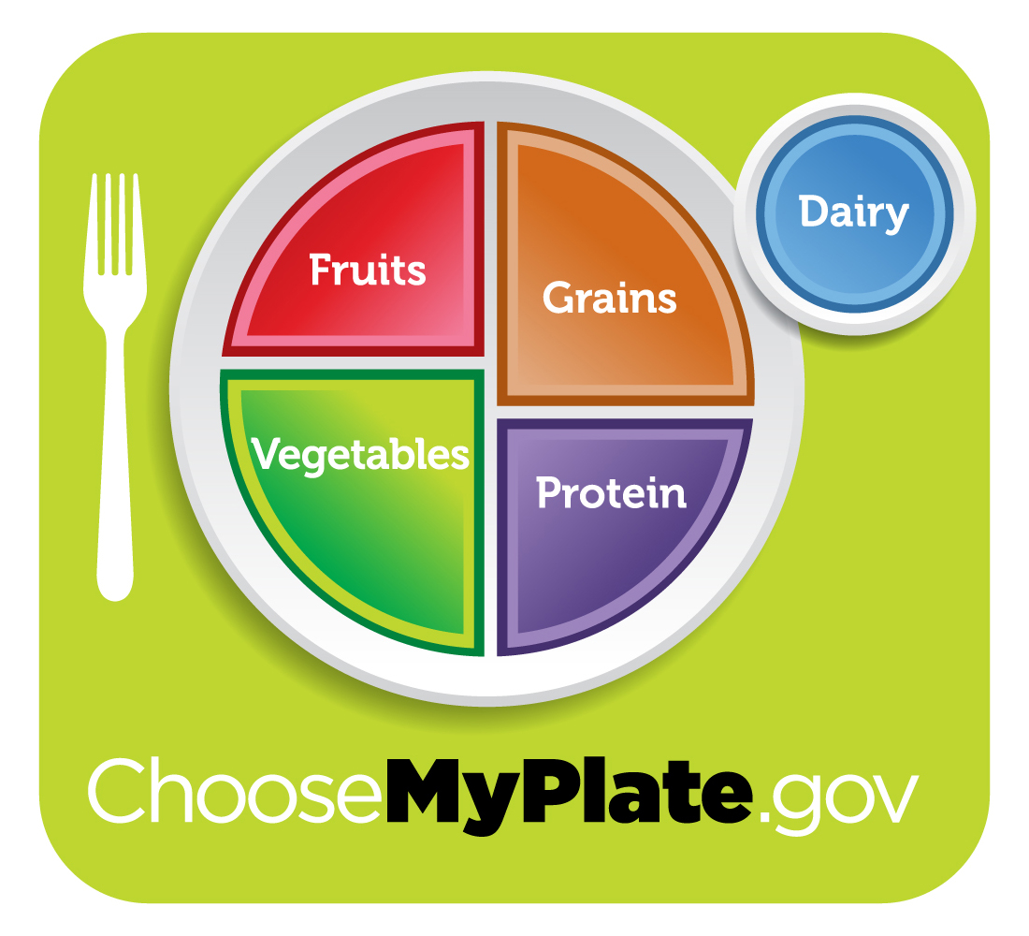
… MyPlate

Slide 3
MyPlate update
MyPlate calls the former MyPyramid “Meat & Beans Group” the “Protein Group”

Slide 4
MyPlate update
MyPlate calls the former MyPyramid “Milk Group” the “Dairy Group”

Slide 5
Choose MyPlate “Menu” of Selected Consumer Messages
Balancing calories
Foods to increase
Foods to reduce
Notes:
Here is what we’ll be covering today from the Selected Consumer Messages from Choose MyPlate. Find more information, check ChooseMyPlate.gov

Slide 6
Choose MyPlate “Menu”
Balancing calories
Enjoy your food, but eat less
Avoid oversized portions
Notes:
These are two main messages under “Balancing calories.”

Slide 7
Food is to be enjoyed!
“Food is not nutritious until its eaten.” ~ Smarter Lunchrooms 2011
Notes:
Eating is one of life’s pleasures. Use MyPlate to plan healthy, enjoyable meals!

Slide 8
Enjoy — but eat less!
100 extra calories
per day
10 extra pounds
per year!
Notes:
It doesn’t take many extra calories a day to add 10 pounds a year! The good news is by reducing daily calorie intake by 100 calories, you can lose 10 pounds per year.

Slide 9
Enjoy — but eat less!
100 extra calories
per day
10 extra pounds
per year!

Slide 10
Eat until “satisfied,” not “full”
“Your stomach shouldn’t be a waist (waste) basket.”
~ Author Unknown
Notes:
Eat only until you are satisfied, not full. If you tend to overeat, be aware of the time of day, place and your mood while eating so you can better control the amount you eat.

Slide 11
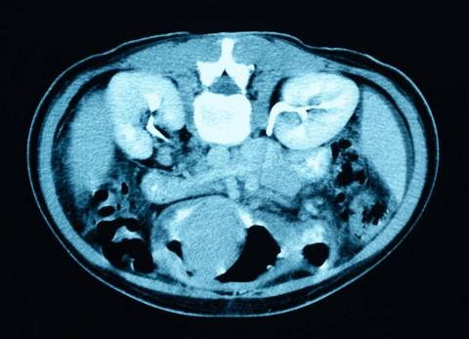
It takes about 20 minutes for stomach to tell your brain you’re full
20 minutes
11
Notes:
Slow down to slim down!

Slide 12
Downsize portion size
The bigger the portion, the more people tend to eat
Notes:
Research indicates the larger the portion, the more we tend to eat. Take less. Serve on smaller plates. Use narrow vs. wide glasses. Order a smaller portion. Split with a friend. Ask for a to-go-box right away and put half the meal away so you can’t see it. Review the calorie content of foods and beverages offered and choose lower-calorie options. Calorie information may be available on menus, in a pamphlet, on food wrappers, or online.

Slide 13
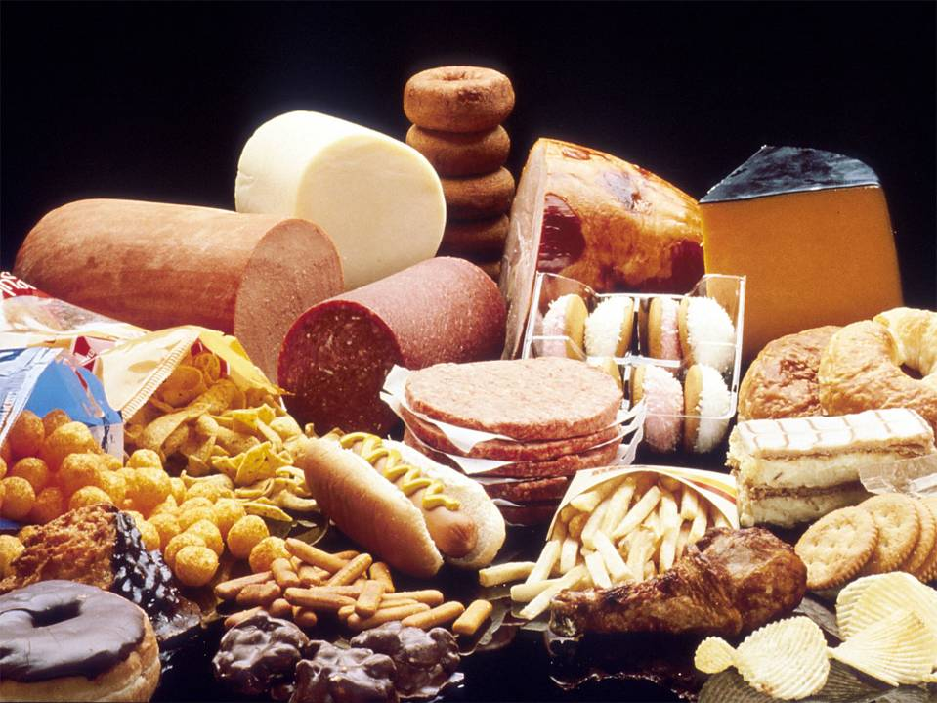
Limit foods high in sodium, added sugars, and refined grains
Photo courtesy of National Cancer Institute
Notes:
NOTE: This slide is for illustration purposes only. In real life, raw meat would not be placed next to foods that would be eaten uncooked.

Slide 14
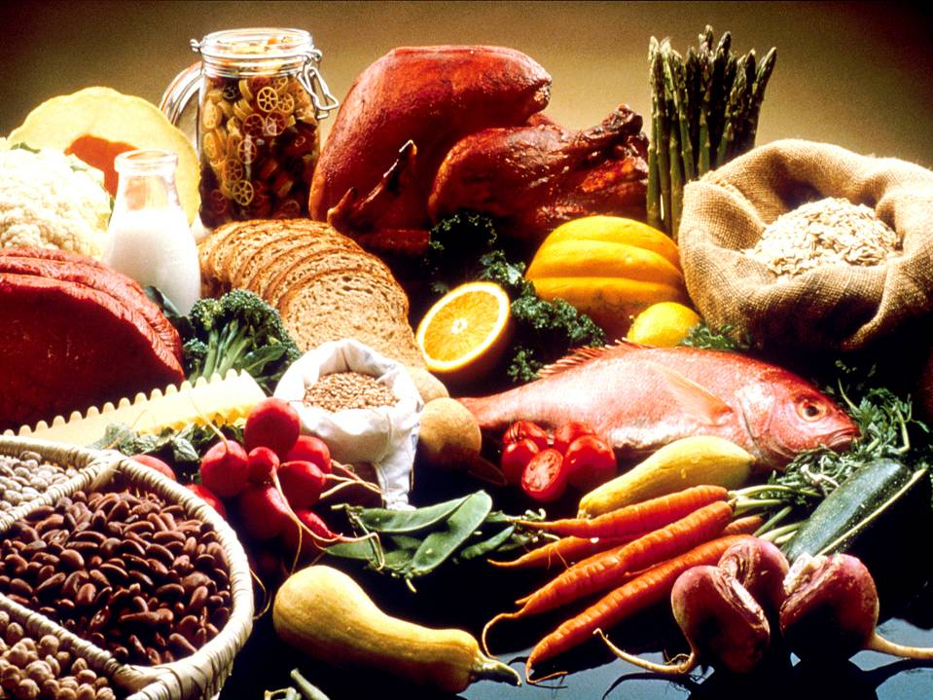
Eat more nutrient- dense foods
Photo courtesy of National Cancer Institute
14
Notes:
NOTE: This slide is for illustration purposes only. In real life, raw meat would not be placed next to foods that would be eaten uncooked.

Slide 15
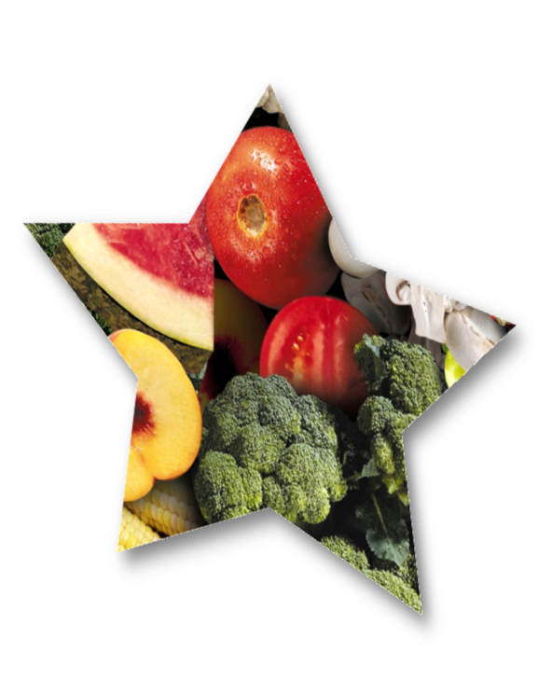
Another name for “nutrient-dense” foods is “nutrient-rich” foods

Slide 16
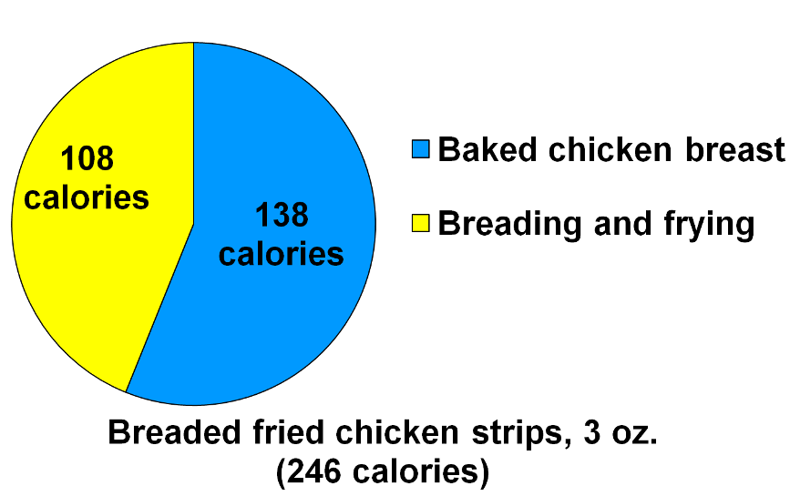
Nutrient-dense vs. not nutrient-dense
Notes:
This figure illustrates the concept of nutrient-dense foods comparing a baked form of chicken with a breaded and fried form.
Data from the U.S. Department of Agriculture, Agricultural Research Service, Food and Nutrient Database for Dietary Studies 4.1. http:// www.ars.usda.gov/Services/doc

Slide 17
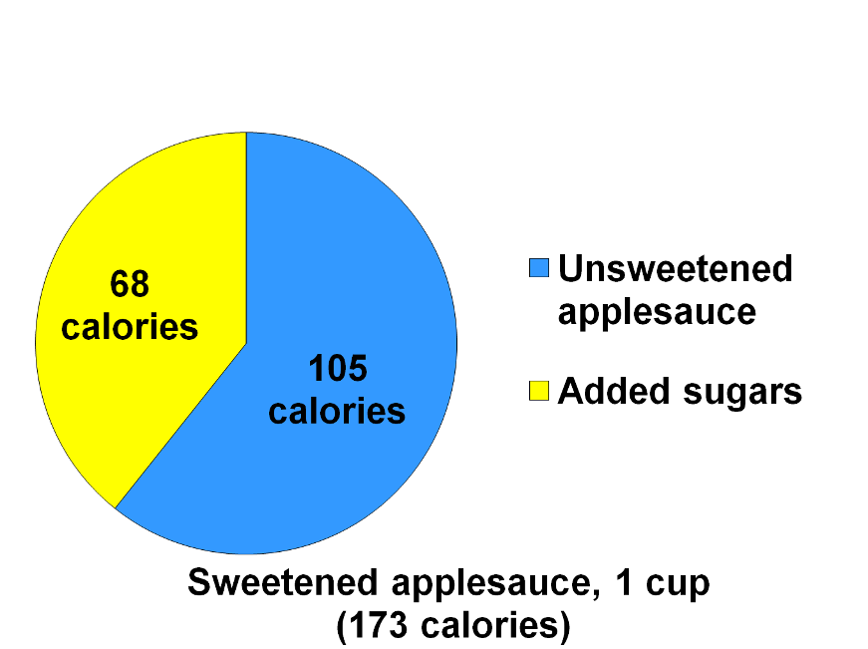
Nutrient-dense vs. not nutrient-dense
Notes:
This slide illustrates the added calories from added sugar.
Source: Based on data from the U.S. Department of Agriculture, Agricultural Research Service, Food and Nutrient Database for Dietary Studies 4.1. http:// www.ars.usda.gov/Services/doc

Slide 18
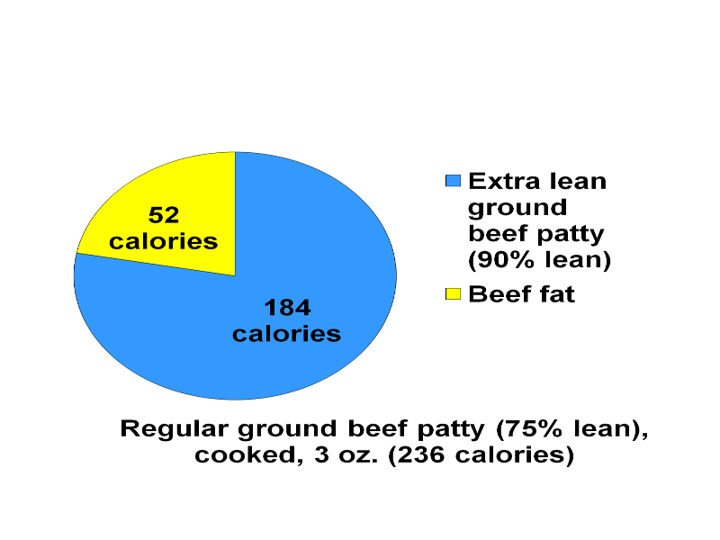
Nutrient-dense vs. not nutrient-dense
Notes:
This figure illustrates the concept of nutrient-dense foods comparing a leaner form of meat with a form containing more fat.
Source: Based on data from the U.S. Department of Agriculture, Agricultural Research Service, Food and Nutrient Database for Dietary Studies 4.1. http:// www.ars.usda.gov/Services/doc

Slide 19
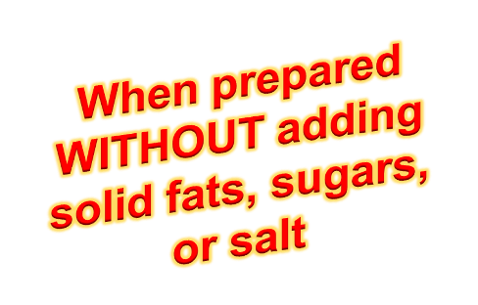
Nutrient-dense foods and beverages include ALL:
Vegetables/fruits
Whole grains
Seafood
Eggs
Dry beans/peas
Unsalted nuts/seeds
Fat-free/low-fat milk/milk products
Lean meats/poultry

Slide 20
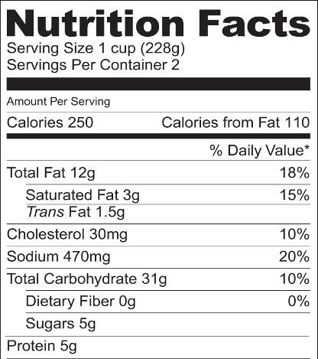
Nutrition Facts Label doesn’t separate “added” & “naturally occurring” sugars
“Added” sugars are sugars and syrups added to foods or beverages during preparation or processing
1 teaspoon sugar = about 4g of added and/or naturally occurring sugar
Notes:
Sometimes when people see the word “sugar” on the Nutrition Facts Label of a food that has “naturally occurring” sugar, such as milk, fruit, or some vegetables, they may feel they shouldn’t eat it. However, unless a person had to monitor total carbohydrate, it is the “added” sugars that are the concern of the DGA2010.

Slide 21
Other sugars occur “naturally” in foods like milk, fruit, and some vegetables – they aren’t the “added sugars” that are the concern

Slide 22
Can you guess: Which food has ADDED sugar according to the ingredient list?
A. INGREDIENTS: cultured pasteurized grade A nonfat milk, whey protein concentrate, pectin ...
B. INGREDIENTS: cultured grade A reduced fat milk, apples, high-fructose corn syrup, cinnamon, nutmeg, natural flavors, pectin ...

Slide 23
Can you guess: Which food has ADDED sugar according to the ingredient list?
A. INGREDIENTS: cultured pasteurized grade A nonfat milk, whey protein concentrate, pectin ...
B. INGREDIENTS: cultured grade A reduced fat milk, apples, high-fructose corn syrup, cinnamon, nutmeg, natural flavors, pectin ...
Notes:
Answer: B. If you are uncertain whether the sugar shown on the Nutrition Facts Label is “added” or “naturally occurring,” check the list of ingredients. Look for such words as syrup, sugar, honey, molasses, dextrin, and words ending on “ose” (such as dextrose, fructose, lactose, maltose, sucrose).

Slide 24
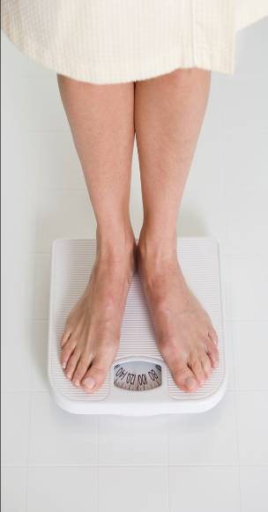
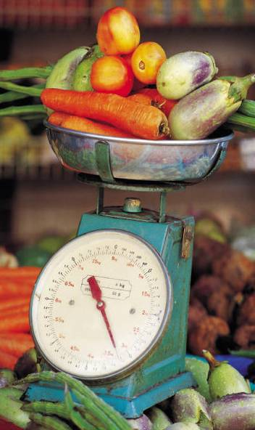
Physical activity and diet important regardless of weight!
Notes:
Attaining a desirable weight isn’t enough to be healthy if you didn’t following a healthy diet and physical activity to attain it.

Slide 25
“My idea of exercise is a good brisk sit.” ~ Phyllis Diller
Notes:
NOT!

Slide 26
Can you guess: How much WEEKLY physical activity should adults (age 18 and over) do for substantial health benefits?
A. 2 hours and 30 minutes of moderate-intensive activity (i.e. 30 minutes, 5 times/week)
B. 1 hour and 15 minutes of vigorous-intensity activity (i.e. 15 minutes, 5 times/week)
C. Either A or B

Slide 27
Can you guess: How much WEEKLY physical activity should adults (age 18 and over) do for substantial health benefits?
A. 2 hours and 30 minutes of moderate-intensive activity (i.e. 30 minutes, 5 times/week)
B. 1 hour and 15 minutes of vigorous-intensity activity (i.e. 15 minutes, 5 times/week)
C. Either A or B
Notes:
Answer: C. Either option or an equivalent combination of the two options is acceptable. Aerobic activity should be performed in episodes of at least 10 minutes, and preferably, it should be spread throughout the week.
For additional and more extensive health benefits, adults should increase their aerobic physical activity to 300 minutes (5 hours) a week of moderate-intensity, or 150 minutes a week of vigorous-intensity aerobic physical activity, or an equivalent combination of moderate- and vigorous-intensity activity.
Additional health benefits are gained by engaging in physical activity beyond this amount. Adults also should include muscle-strengthening activities that involve all major muscle groups on 2 or more days a week.

Slide 28
Moderate aerobic activity increases breathing and heart rate somewhat
Notes:
Moderate activity is aerobic activity that increases a person’s breathing and heart rate somewhat. It includes brisk walking, dancing, swimming, or bicycling on a level terrain.

Slide 29
Vigorous aerobic activity greatly increases heart rate and breathing
Notes:
Examples of vigorous intensity activity that greatly increases a person’s heart rate and breathing include jogging, singles tennis, swimming continuous laps, or bicycling uphill.

Slide 30
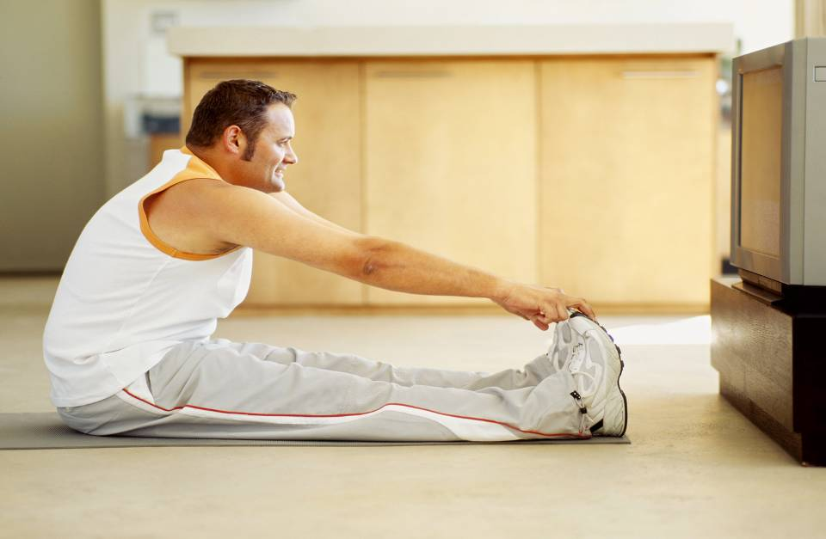
Limit screen time or
watch and workout
Notes:
Are there ways you can workout while you watch TV? Peddle on an exercise bicycle? Walk on a treadmill? Etc.

Slide 31
Short on time?
Get
active
10
minutes
3
times
a day
Notes:
Walk during a break, over the noon hour, while waiting for a load of laundry to get done, after dinner, etc.

Slide 32
Choose MyPlate “Menu”
Foods to increase
Make half your plate fruits and vegetables
Make at least half your grains whole grains
Switch to fat-free or low-fat (1%) milk
Notes:
These are three main messages under “Foods to increase.”

Slide 33
Fill half your plate with fruits & veggies
Notes:
Divide the other half between a lean protein source and a whole grain.

Slide 34
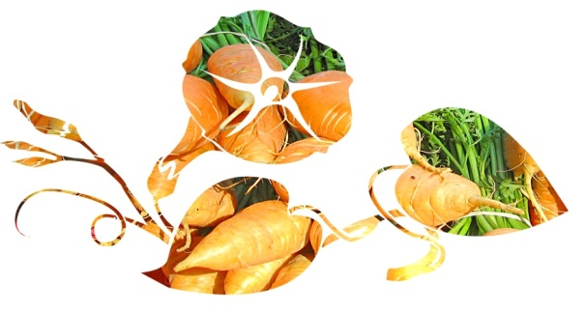
Pick a variety of vegetables from each vegetable subgroup
Red & orange
Beans & peas
(legumes)
Starchy
Dark-green
Other
Notes:
Formerly the Dietary Guidelines included an orange vegetable subgroup. In 2010, they added red foods and now refer to a red-orange subgroup, to include tomatoes, because of the tomato’s nutritive value and the extent to which it occurs in American diets. Tomatoes are high in the antioxidant lycopene. They also are a significant source of vitamin C, fiber and potassium.
Examples of food from the five vegetable subgroups include:
Dark-green vegetables: All fresh, frozen, and canned dark-green leafy vegetables and broccoli, cooked or raw: for example, broccoli; spinach; romaine; collard, turnip, and mustard greens.
Red and orange vegetables: All fresh, frozen, and canned red and orange vegetables, cooked or raw: for example, tomatoes, red peppers, carrots, sweet potatoes, winter squash, and pumpkin.
Beans and peas (legumes): All cooked beans and peas: for example, kidney beans, lentils, chickpeas, and pinto beans. Does not include green beans or green peas. (See additional comment under protein foods group.)
Starchy vegetables: All fresh, frozen, and canned starchy vegetables: for example, white potatoes, corn, green peas.
Other vegetables: All fresh, frozen, and canned other vegetables, cooked or raw: for example, iceberg lettuce, green beans, and onions.

Slide 35
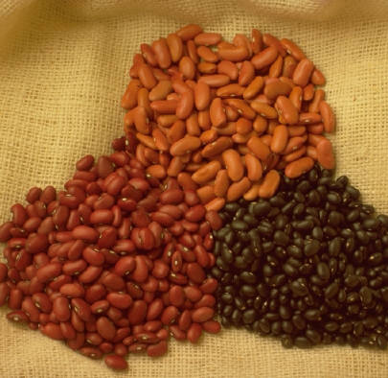
Did you know: The vegetable subgroup of “beans and peas (legumes)” includes ...
… all cooked beans and peas, for example:
Kidney beans
Lentils
Chickpeas
Pinto beans

Slide 36
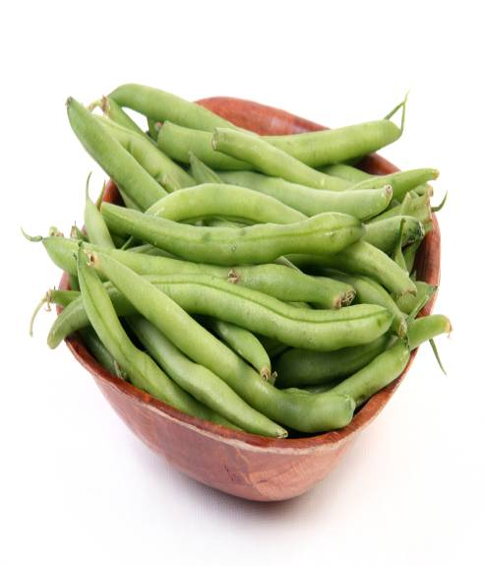
The “beans and peas (legumes)” subgroup does NOT include ...
Green peas
Green beans
Notes:
Green peas are in the “Starchy Vegetables” vegetable subgroup. Green beans are in the “Other Vegetables” vegetable subgroup.

Slide 37
Can you guess: What type of food are “beans and peas (legumes)” considered?
A. Vegetable
B. Protein
C. Both A and B
D. Neither A or B

Slide 38
Can you guess: What type of food are “beans and peas (legumes)” considered?
A. Vegetable
B. Protein
C. Both A and B
D. Neither A or B
Notes:
Answer C. Both A and B. The DGA2010 vegetable subgroup of “beans and peas (legumes)” refers to the mature forms of legumes. It includes kidney beans, pinto beans, black beans, garbanzo beans (chickpeas), lima beans, black-eyed peas, split peas, and lentils.
They contain protein and other nutrients similar to seafood, meat, and poultry. Plus, they are excellent sources fiber and other nutrients which also are found in vegetables.
Green peas and green (string) beans are not considered part of the “beans and peas (legumes)” subgroup.

Slide 39
At least half your grains should be whole grains
Notes:
Moderate evidence shows that adults who eat more whole grains, particularly those higher in dietary fiber, have a lower body weight compared to adults who eat fewer whole grains.

Slide 40
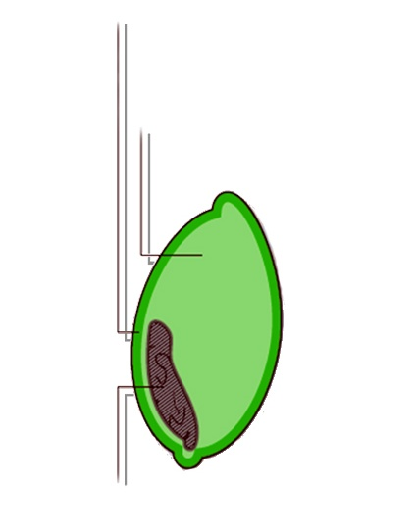
Bran
Whole grains contain the entire grain seed or “kernel”
Endosperm
Germ
Notes:
Whole grains include the entire grain seed, usually called the kernel. The kernel consists of three components—the bran, germ, and endosperm. If the kernel has been cracked, crushed, or flaked, then, to be called a “whole grain” a food must retain the same relative proportions of these components as they exist in the intact grain.
Whole grains are consumed either as a single food (e.g., wild rice or popcorn) or as an ingredient in foods (e.g., in cereals, breads, and crackers). Some examples of whole-grain ingredients include buckwheat, bulgur, millet, oatmeal, quinoa, rolled oats, brown or wild rice, whole-grain barley, whole rye, and whole wheat.

Slide 41
Partially whole grain products providing half or more whole grains per ounce-equivalent serving have at least either:
51% of total weight as whole grains OR
8g of whole grains
Notes:
The Whole Grain Stamp, while not mandatory, is found on many products containing whole grains and is another way to help you choose whole grain products.
Foods with this Stamp guarantee the product contains at least half a serving (8g) of whole grains per serving. Inside the Stamp is a declaration of the grams of whole grains per serving for the particular food.
Here is how the Whole Grains Council describes this Stamp (retrieved March 2, 2011 at http://www.wholegrainscouncil.org/whole-grain-stamp): There are two different varieties of stamp, the Basic Stamp and the 100% Stamp.
- If a product bears the 100% Stamp, then all its grain ingredients are whole grains. There is a minimum requirement of 16g (16 grams) — a full serving — of whole grain per labeled serving, for products using the 100% Stamp.
- If a product bears the Basic Stamp, it contains at least 8g (8 grams) — a half serving — of whole grain, but may also contain some refined grain. Even if a product contains large amounts of whole grain (23g, 37g, 41g, etc.), it will use the Basic Stamp if it also contains extra bran, germ, or refined flour.

Slide 42
3 ways to eat half whole grains
3 oz. 100% whole grains & 3 oz. refined-grain products
2 oz. 100% whole grains, 2 oz. partly whole-grain products, & 2 oz. refined grain products
6 oz. partly whole-grain products
Notes:
This slide shows an example of a explanatory graphic from the DGA2010 Guidelines. The actual Guideline for whole grains is “consume at least half of your grains as whole grains,” and this figure shows 3 different ways of how someone could choose to make half of their total grain intake whole grain, using bread as an example.

Slide 43
Can you guess: Which bread is highest in WHOLE grains?
A. INGREDIENTS: wheat flour, water, high fructose corn syrup, molasses, wheat, bran ...
B. INGREDIENTS: whole wheat flour, water, brown sugar ...

Slide 44
Can you guess: Which bread is highest in WHOLE grains?
A. INGREDIENTS: wheat flour, water, high fructose corn syrup, molasses, wheat, bran ...
B. INGREDIENTS: whole wheat flour, water, brown sugar ...
Notes:
Answer: B. a “whole grain” should be the first ingredient or the second ingredient, after water. For foods with multiple whole-grain ingredients, they should appear near the beginning of the ingredients list.

Slide 45
Switching to fat-free or low-fat (1%) milk makes a difference!
Whole | 2% | 1% | Fat-free
165 calories | 125 calories | 100 calories | 85 calories
Calories saved | 40 | 65 | 80
Notes:
Choosing fat-free or1% low-fat milk and milk products provides the same nutrients with less solid fat and thus fewer calories.
Soy beverages fortified with calcium and A and D are considered part of the milk and milk products group because they are similar to milk both nutritionally and in their use in meals.

Slide 46
Can you guess: Which is more nutrient-dense?
A. Fat-free and low fat (1%) milk
B. Whole milk
C. They are equally nutrient-dense

Slide 47
Can you guess: Which is more nutrient-dense?
A. Fat-free and low fat (1%) milk
B. Whole milk
C. They are equally nutrient-dense
Notes:
Answer: A. Increase your intake of fat-free or low-fat (1%) milk and milk products, such as milk, yogurt, cheese, or fortified soy beverages. If you are drinking whole milk, gradually switch to lower fat options. If you are drinking whole milk, go to 2% and move on down to 1% low-fat or fat-free milk. Lower fat milk provides the same nutrients as higher fat milk, but is lower in calories and saturated fat while still providing essential nutrients (calcium, protein, etc.).

Slide 48
Choose MyPlate “Menu”
Foods to reduce
Compare sodium in foods like soup, bread, and frozen meals ― and choose the foods with lower numbers
Drink water instead of sugary drinks
Notes:
These are two main messages under “Foods to reduce.”

Slide 49
Can you guess: People ages 2 and older should reduce daily sodium intake to less than …
A. 2,300 mg or 1,500 mg, depending on age/other individual characteristics
B. 2,300 mg or 3,000 mg, depending on age/other individual characteristics

Slide 50
Can you guess: People ages 2 and older should reduce daily sodium intake to less than …
A. 2,300 mg or 1,500 mg, depending on age/other individual characteristics
B. 2,300 mg or 3,000 mg, depending on age/other individual characteristics
Notes:
Answer: A. 2,300 mg or 1,500 mg, depending on age/other individual characteristics

Slide 51
Groups reduced to 1,500 mg
African Americans ages 2+
Adults ages 51+
People ages 2+ with high blood pressure, diabetes, or chronic kidney disease
_{Ages 2+}
Notes:
The 1500 mg recommendation applies to half the total population (ages 2+) and to the majority of adults.

Slide 52
Can you guess: How much sodium is in a teaspoon of salt?
A. 1,300 mg
B. 2,300 mg
C. 3,300 mg

Slide 53
Can you guess: How much sodium is in a teaspoon of salt?
A. 1,300 mg
B. 2,300 mg
C. 3,300 mg
Notes:
Answer: B. 2,300 mg

Slide 54
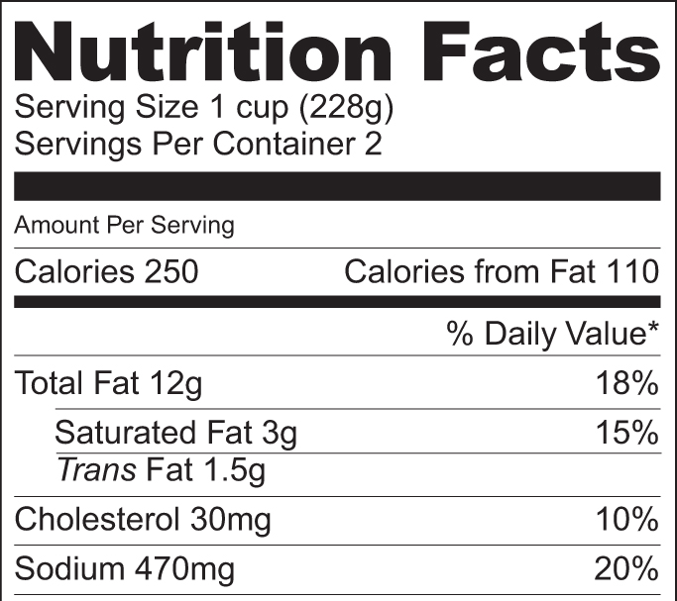
Can you guess: How much sodium is in 1 cup of this food?
A. 30 mg
B. 250 mg
C. 470 mg

Slide 55
Can you guess: How much sodium is in 1 cup of this food?
A. 30 mg
B. 250 mg
C. 470 mg
Notes:
Answer: C. 470 mg.

Slide 56
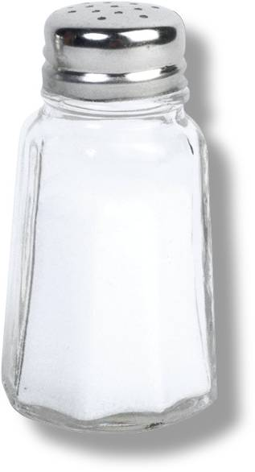
Easy ways to reduce sodium
Check labels
Avoid adding salt (an exception may be when baking yeast breads)
Eat fresh foods, frozen veggies
Request salt be left off when eating out
Use other seasonings
Notes:
NOTE: Salt is typically used in yeast breads and other bread-type products made with yeast to regulate the growth of the yeast and prevent the food from rising too rapidly. While yeast breads can be made without salt, modifications in the ingredients and recipe techniques are usually made to create a product with a satisfactory texture. As salt also adds flavor, most bread is still made with salt.

Slide 57
Reduce sugar-sweetened beverage intake:
Drink fewer sugar-sweetened beverages
Consume smaller portions
Substitute water, unsweetened coffee and tea, and other beverages with few or no calories
Notes:
Strong evidence shows children and adolescents who consume more sugar-sweetened beverages have higher body weight compared to those who drink less, and moderate evidence also supports this relationship in adults.
Sugar-sweetened beverages provide excess calories and few essential nutrients to the diet and should only be consumed when nutrient needs have been met and without exceeding daily calorie limits.
Reduce the intake of these beverages by: drinking fewer sugar-sweetened beverages, consuming smaller portions, substituting water, unsweetened coffee and tea, and other beverages with few or no calories. Read the label or see new front of pack calorie information on an increasing number of beverages."

Slide 58
Remember …
A variety of foods, in moderation, can fit into a healthy eating pattern if nutrient needs have been met without exceeding calorie limits.
Regular physical activity helps maintain calorie balance.

