Slide 1
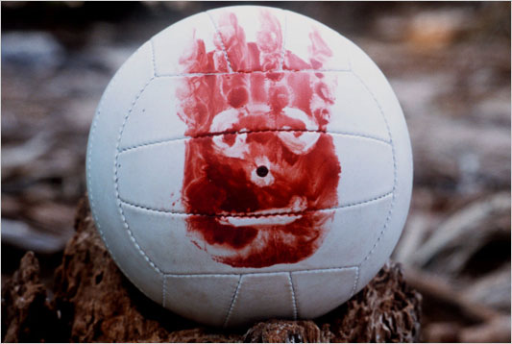
Maslow’s Hierarchy of Human Needs
Connections to the movie Cast Away,
starring Tom Hanks and Wilson.

Slide 2
Maslow’s Theory
Self-Actualization
Esteem
Love and Belonging
Physical
Safety and Security

Slide 3
Esteem
Safety/security
Physical
Self-actualization
Love/belonging

Slide 4
Physical Needs
Food
Sleep
Exercise
Shelter
Water
Air
Sex
Physical
Notes:
Some may want to delete the word sex, depending on teacher’s comfort level and maturity of students.

Slide 5
Safety and Security Needs
Stability
Freedom from Danger
Financial Security Personal Safety
Windows and Doors with Locks
Safety and Security

Slide 6
Love and Belonging Needs
Affection
Approval
Companionship
Acceptance
Love and Belonging

Slide 7
Esteem Needs
Respect from others
Self Respect
Pride
Meaningful Career
Esteem

Slide 8
Self-Actualization
Fulfilling one’s potential
Concern for Humanity
Ethical
Compassionate
Creative
Self-
Actualization

Slide 9
The Theory
First concern is to fulfill the lowest level of unsatisfied need
Motivation to satisfy needs produces growth
When need is met, it becomes less important and the next level of need becomes the focus
If needs are not met, misbehavior or mental illness may occur
During crisis decisions will be made to secure basic needs

Slide 10

Connection to Castaway
Chuck had everything until the crash. Now he is on an uninhabited island and is working to meet his basic human needs. Watch the following clip.
Cast Away Introduction.

Slide 11
Connection to Cast Away
In the movie Cast Away, Chuck has to supply his basic physical needs with things he finds on the island; like coconuts, fish & crabs (raw at first), gather water and create a shelter tent.
Physical

Slide 12
Connection to Castaway
Chuck’s life changes forever. His safety and security is taken away.
Watch the Plane Crash
Safety and Security

Slide 13
Connection to Castaway
Chuck has family and friends that love him. Before the accident Chuck gave his girlfriend an engagement ring and then said, I'll be right back!
Love and Belonging

Slide 14
Connection to Cast Away
Fire means a lot to Chuck. It is a signal for search planes and no more raw food! I HAVE MADE FIRE!
Esteem

Slide 15
Connection to Castaway
What areas of Maslow’s Hierarchy of Human Needs do you see in this clip:
Never Again, Never Again

Slide 16
Connection to Castaway
Would you be brave enough to sail away from the island?
Escape to Sea

Slide 17
Connection to Cast Away
During crisis decisions will be made to secure basic needs:
I'm Sorry Wilson!
What would you do?

Slide 18
Connection to Cast Away
What would you do if you were
Standing at the Crossroads

Slide 19

Time to Reflect
After watching this last clip, please write a reflection answer to the following question:
If you were Chuck,
what would you do next?

