Slide 1
CVD statistics
Cardiovascular disease (CVD) is the leading cause of death in the U.S.
CVD is the number one killer in the U.S.
More that 2,500 Americans die from CVD each day
Among women, 1 in 2.6 deaths from CVD

Slide 2
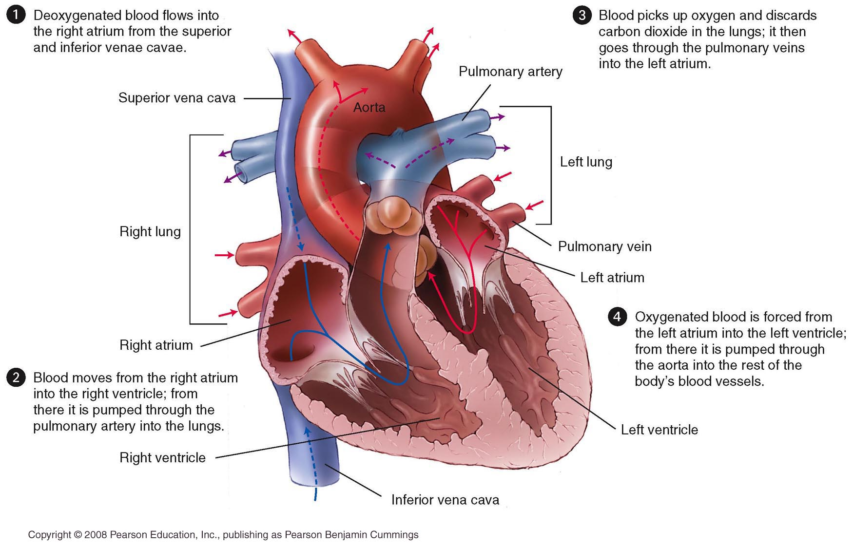
Anatomy of the Heart
Figure 15.4

Slide 3
Common Types of Cardiovascular Disease
Hypertension
Atherosclerosis
Arteriosclerosis
Coronary heart disease (CHD)
Chest pain (angina pectoris)
Irregular heartbeat (arrhythmia)
Stroke
Congestive heart failure (CHF)
Congenital and rheumatic heart disease

Slide 4
Object description
Each group assigned a type of cardiovascular disease
Read description in lesson 65
Create an object description definition
Share with the class
Record other groups’ definitions on your worksheet

Slide 5
atherosclerosis
arteriosclerosis-
hardening of the arteries
atherosclerosis-
fatty deposits narrow the arteries
Plaque – the buildup of deposits in the arteries

Slide 6
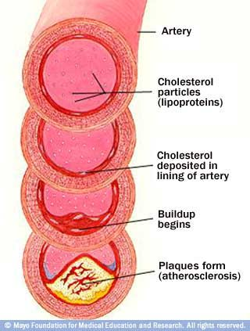
http://health.howstuffworks.com/adam-200034.htm

Slide 7
Heart attack
Myocardial infarction (MI) or heart attack – blood supplying the heart is disrupted
Coronary thrombosis – blood clot in the artery
Embolus – when the blood clot is dislodged and moves through the circulatory system
http://www.healthcentral.com/animation/408/13/Heart_Attack.html

Slide 8
Heart attack cont’d
cardiac arrest- heart stops completely
CPR- combo. of mouth to mouth breathing and chest compressions
AED- automated external defibrillator

Slide 9
Heart attack cont’d
Warning signs:
uncomfortable pressure/pain for two minutes or more
spreading to shoulder, neck, arms
dizziness, fainting, sweating,
shortness of breath

Slide 10
Angina Pectoris
Ischemia – reduction of the heart’s blood and oxygen supply
The more serious the oxygen deprivation the more severe the pain

Slide 11
Stroke
a sudden disruption of blood flow to a section of the brain
Effects of Stroke

Slide 12
Stroke cont’d
Occurs when the blood supply to the brain is interrupted
Thrombus – blood clot
Embolus – free flowing clot
Aneurysm – bulging or burst blood vessel
Transient ischemic attack (TIA) – brief interruptions that cause temporary impairment

Slide 13
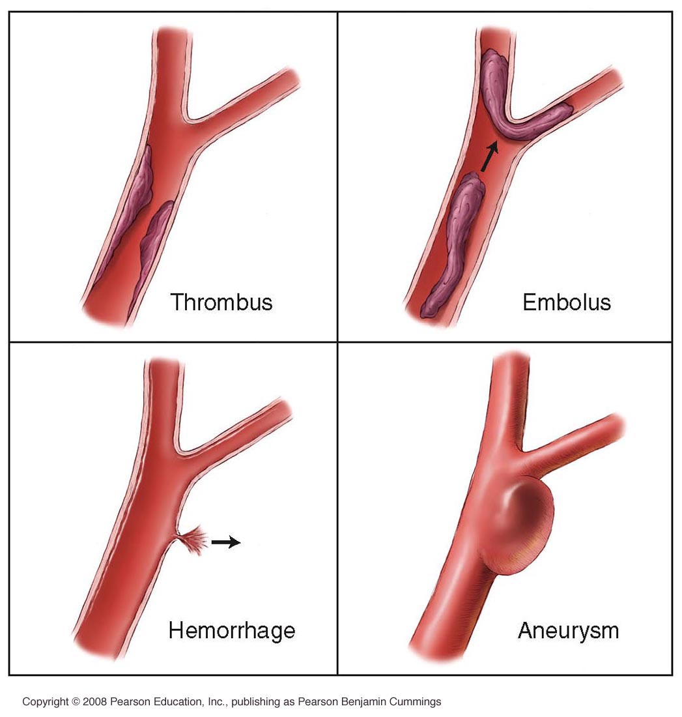
Figure 15.6

Slide 14
Stroke cont’d
Warning signs:
weakness, numbness in face, arm, leg
trouble with speech
vision impairment/loss
dizziness, nausea, unsteadiness

Slide 15
Stroke assessment
Face weakness
Arm weakness
Speech problems
Time symptoms started

Slide 16
Arrhythmia
A heart condition in which the heartbeat is abnormal and irregular.
The heart may beat very slowly or very fast for no apparent reason.
Fibrillation – heart beat is sporadic, quivering pattern

Slide 17
hypertension
High blood pressure
blood pressure- the force of blood pushing against the walls of blood vessels
http://health.howstuffworks.com/adam-200079.htm

Slide 18
Hypertension cont’d
systolic pressure- heart contracts, sound
diastolic pressure- heart relaxes, no sound
safe range: 120/80 to 130-85; 140/90 = high

Slide 19
Hypertension cont’d
Called the “silent killer” because there are no symptoms and it often goes undetected

Slide 20
Student Reflection
Complete Personal Assessment #5 questions 4 and 5
Hand in for a grade!

Slide 21
Exit ticket
a blockage of the coronary artery leading to the heart
high blood pressure (140/90 or higher)
fatty deposits build up in arteries
a blockage of the coronary artery leading to the brain
chest pains due to narrowed arteries
stroke
hypertension
heart attack
angina
atherosclerosis

Slide 22
Detecting CVD
electrocardiogram-
graph of heart’s electrical activity that can show abnormalities

Slide 24
Detection of CVD
heart catheterization- injects dye to track blood flow and finds the blockage

Slide 25
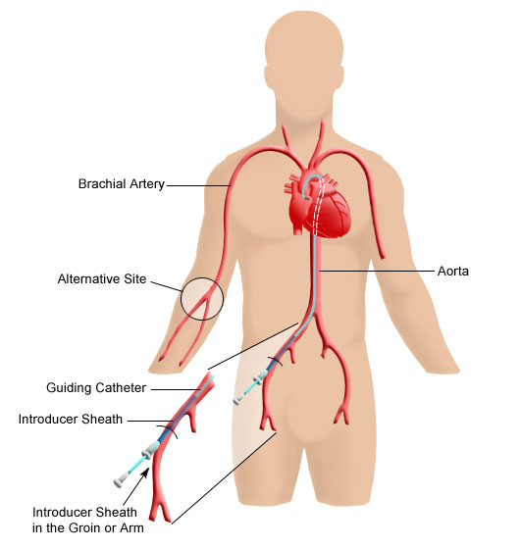

Slide 26
Treating CVD
Drugs:
Nitroglycerin – drug used to relax
(dilate) the veins
Beta blockers control potential overactivity of the heart muscle
Aspirin therapy
Thrombolysis

Slide 27
Treating CVD
angioplasty- balloon or laser
balloon compresses plaque against artery wall
laser dissolves plaque

Slide 28
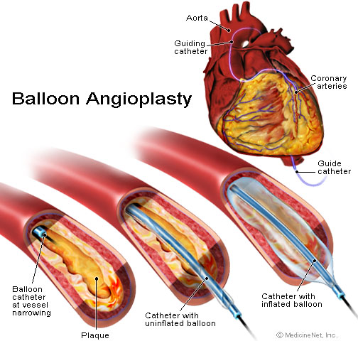
Angioplasty

Slide 29
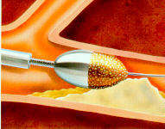
Treating CVD
atherectomy- drill like catheter removes plaque

Slide 30
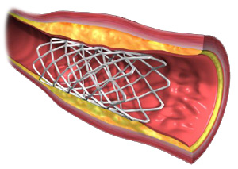
Treating CVD
Stent- wire mesh tube keeps artery wall open
Stent Angioplasty

Slide 31
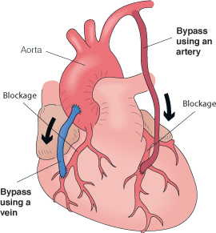
Treating CVD
coronary bypass surgery- use of a vein to construct a detour around the blocked artery
Bypass Surgery

Slide 32
Treating CVD
pacemaker-produces electrical impulses for the heart; prevents fibrillation (uneven rhythm)

Slide 33
Coronary Care Game
Discover your life expectancy based on your cardiovascular disease risk factors

Slide 34
Uncontrollable Risk Factors for CVD
Increasing age
Gender
Heredity
Race

Slide 35
Controllable Risk Factors for CVD
Smoking
High blood cholesterol
Hypertension (high blood pressure)
Physical inactivity
Obesity/
overweight
Diabetes
High stress levels
Alcohol use

Slide 36
Prevention of CVD
do not smoke
if you smoke, quit
check blood pressure regularly
reduce cholesterol
reduce salt

Slide 37
Prevention of CVD cont’d
exercise regularly
avoid obesity
manage stress

