Slide 1
Slides provided by
the USDA Center for Nutrition Policy and Promotion
Notes:
Note: This slide deck was prepared by USDA’s Center for Nutrition Policy and Promotion and may be used by professionals, either in its entirety or as selected slides, in presentations about the Dietary Guidelines for Americans, 2010. If you are on the same panel as Center for Nutrition Policy and Promotion staff, please be aware that these slides will be used by the staff and you should coordinate presentations appropriately to avoid duplication.
The Dietary Guidelines for Americans, 2010, is the centerpiece of Federal nutrition policy and guidance. This document sets the foundation for the work of policymakers and many nutrition educators, nutritionists, and dietitians. This presentation covers the process of establishing the Dietary Guidelines and the highlights of the policy.
Questions about the policy can be sent to Dr. Robert Post, Deputy Director, Center for Nutrition Policy and Promotion, USDA -- Robert.Post@cnpp.usda.gov.

Slide 2
Chapter 1 Introduction
Describes 2010 Dietary Guidelines development
Identifies their uses
Explains their importance for health promotion and disease prevention
Highlights the heavy toll of diet-related diseases
Provides a “roadmap” to the rest of the document
Explains strength of the evidence
Defines several key terms
Notes:
The introduction describes the development process; identifies the various uses of the Guidelines; explains their importance for health promotion and disease prevention; and highlights the heavy toll of diet-related diseases.

Slide 3
Key term definition “Nutrient Dense”
Nutrient-dense foods and beverages:
Provide vitamins, minerals, and other beneficial substances and relatively few calories without
Solid fats in the food or added to it
Added sugars
Added refined starches
Added sodium
Retain naturally occurring components, such as dietary fiber
All vegetables, fruits, whole grains, seafood, eggs, beans and peas, unsalted nuts and seeds, fat-free and low-fat dairy, and lean meats and poultry are nutrient dense when prepared without solid fats or sugars
Notes:
An example of one of those terms is “nutrient-dense” which is defined as foods and beverages that provide vitamins, minerals, and other substances that have positive health effects—with relatively few calories.
The term “nutrient dense” indicates that the nutrients and other beneficial substances in a food have not been “diluted” by the addition of calories from added solid fats, added sugars, or added refined starches, or by solid fats naturally present in a food, such as the fat in meats, poultry, fluid milk, and other milk products, such as cheese. The fat in fluid milk fat is considered to be a “solid fat.” It is solid at room temperature, but is suspended in milk by the process of homogenization.
Nutrient-dense foods and beverages are lean or low in solid fats, and minimize or exclude added solid fats, sugars, starches, and sodium. Ideally, they also are in forms that retain naturally occurring components, such as dietary fiber.
All vegetables, fruits, whole grains, seafood, eggs, beans and peas, unsalted nuts and seeds, fat-free and low-fat milk and milk products, and lean meats and poultry—when prepared without adding solid fats, sugars, or salt—are nutrient-dense foods.

Slide 4
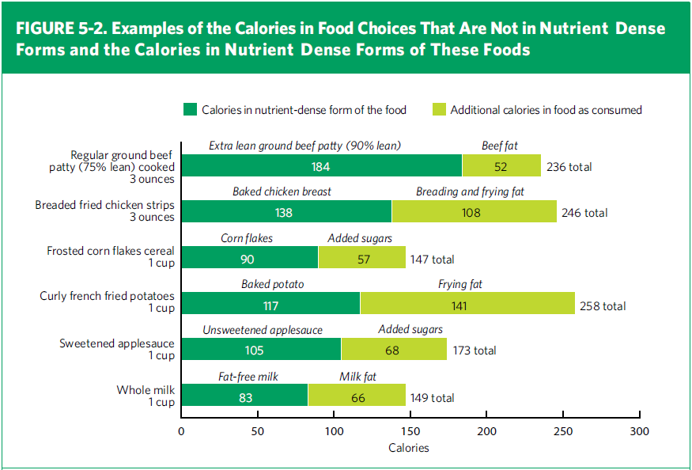
Nutrient Dense and Non-Nutrient Dense Forms of Sample Foods
Notes:
This figure illustrates the concept of nutrient-dense foods. (It is found in chapter 5 of the DGA policy document)
The full length of the bars corresponds to the number of calories in a serving of the foods listed on the far left, which are not in nutrient-dense forms. The dark-green portion of the bars shows the number of calories that would be in the same food if it were in its nutrient-dense form. The lighter green portion shows how many additional calories are attributable to the naturally occurring solid fat in the ground beef, the breading and the frying fat in the chicken, the added sugars in the cornflakes, the frying fat in the potatoes, the added sugars in the applesauce, and the naturally occurring fat in the milk. The foods listed in the dark-green portions of the bars are all foods in their nutrient-dense form.
[Foods in figure:
Regular ground beef patty, 236 calories: extra lean ground beef patty, 184 calories, and beef fat, 52 calories
Breaded fried chicken strips, 246 calories: Baked chicken breast, 138 calories, and breading and frying fat, 108 calories
Frosted corn flakes cereal, 147 calories: cornflakes, 90 calories, added sugars 57 calories
Curly french fried potatoes, 258 calories: baked potato, 117 calories, frying fat, 141 calories
Sweetened applesauce, 173 calories: unsweetened applesauce, 105 calories, added sugars, 68 calories
Whole milk, 149 calories: fat-free milk, 83 calories, milk fat, 66 calories]

Slide 5
Chapter 2 Balancing Calories to Manage Weight
Epidemic of overweight and obesity in all segments of our society new
Environmental factors contribute to weight gain
Calorie balance over time is key
Important modifiable factors
Calories consumed in foods and beverages
Calories expended in physical activity
Strong evidence for no optimal proportion of macronutrients for weight loss
Notes:
The overall environment has contributed to the obesity epidemic.
Calorie balance over time is the key to weight management. Many Americans are in calorie imbalance – that is, they consume more calories than they expend.
The number of calories consumed is the essential dietary factor that affects body weight. Understanding calorie needs, knowing the calorie content of foods and beverages, and recognizing the association between food and beverage intake and body weight are all important concepts that can promote calorie balance and weight management.
Physical activity should also be considered when addressing weight management. Getting adequate amounts of physical activity conveys many health benefits independent of body weight.
Another important point in this chapter is that the systematic review concluded there is strong evidence that when calorie intake is controlled, macronutrient proportion is not related to weight loss.

Slide 6
Top Sources of Calories Among Americans 2 Years and Older
1. Grain-based desserts
Cake, cookies, pie, cobbler, sweet rolls, pastries, and donuts
2. Yeast breads
White bread and rolls, mixed-grain bread, flavored bread, whole-wheat bread, and bagels
3. Chicken and chicken mixed dishes
Fried and baked chicken parts, chicken strips/patties, stir-fries, casseroles, sandwiches, salads, and other chicken mixed dishes
4. Soda/energy/sports drinks
Sodas, energy drinks, sports drinks, and sweetened bottled water including vitamin water
5. Pizza
Source: NHANES 2005-2006, Available at http://riskfactor.cancer.gov/diet/foodsources/
Notes:
The top sources of calories have been estimated using data from the National Health and Nutrition Examination Survey, 2005-06. For this analysis and others like it found in the policy document in pie charts, foods and beverages reported in the survey were grouped into 97 categories. Here the categories were ranked according to calorie contribution to the diet. The number one calorie contributor in the diets of Americans ages 2 years is grain-based desserts, followed by yeast breads, chicken and chicken mixed dishes, soda and energy and sports drinks, and pizza.
Although some of these are important sources of nutrients, others provide calories with few nutrients. Many of the foods and beverages most often consumed within these categories are high in solid fats and/or added sugars, thereby contributing excess calories to the diet. For example, grain-based desserts are typically high in added sugars and solid fats; and chicken is often breaded and fried, and that adds a substantial number of calories to the chicken.
[Additional information:
Total mean intake = 2,157 kcal/d
Calories from each of the top 5 sources:
Grain-based desserts (138 kcal/d)
Yeast breads (129 kcal/d)
Chicken and chicken mixed dishes (121 kcal/d)
Soda/energy/sports drinks (114 kcal/d)
Pizza (98 kcal/d)
Source: NHANES 2005-2006, Available at http://riskfactor.cancer.gov/diet/foodsources/ ]

Slide 7
Top Sources of Calories by Age Group
Alcoholic beverages are a major calorie source for adults
Sodas and pizza contribute more calories among adolescents than younger children
Fluid milk is a top calorie source for younger children
Notes:
Top calorie sources differ by age group.
For example:
Alcoholic beverages are a major calorie source for adults.
Sugar-sweetened beverages are a greater calorie contributor among adolescents than younger children (ages 2-8).
Fluid milk is a top calorie source for younger children.

Slide 8
Principles for Promoting Calorie Balance
Monitor food and beverage intake, physical activity, and body weight
Reduce portion sizes
When eating out, make better choices
Limit screen time
Notes:
Chapter 2 also identifies behaviors and practices that have been shown to help people manage their food and beverage intake and calorie expenditure and ultimately to manage body weight:
Monitor food and beverage intake, physical activity, and body weight. Self-monitoring helps people become more conscious of what they eat and what they do.
Reduce portion sizes. Prepare, serve, and consume smaller portions of foods and beverages, especially those high in calories.
Make better choices when eating out. When eating out, choose smaller portions or lower-calorie options.
Limit screen time. In addition to increasing physical activity, reducing sedentary time is important. Television viewing is directly associated with overweight and obesity.

Slide 9
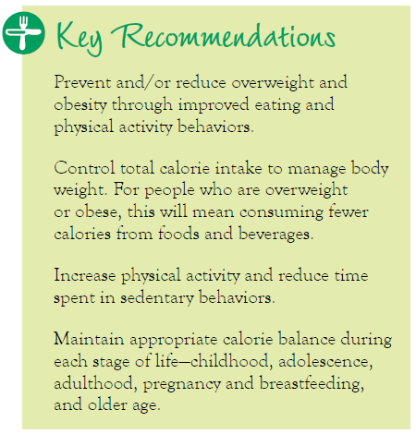
Chapter 2 Balancing Calories to Manage Weight
Notes:
The Chapter 2 Key Recommendations are listed here

Slide 10
Chapter 3 Foods and Food Components to Reduce
Topics covered
Sodium
Fats
Saturated fatty acids
Trans fatty acids
Cholesterol
Calories from solid fats and added sugars
Refined grains
Alcohol
Notes:
The topics covered in this chapter are:
Sodium;
Fats, including saturated fatty acids, trans fatty acids, and cholesterol;
Calories from solid fats and added sugars;
Refined grains; and
Alcohol.

Slide 11
Chapter 3 Foods and Food Components to Reduce
Sodium
Reduce intake to less than 2300 mg per day
Further reduce intake to 1500 mg per day for
Adults ages 51+
African Americans ages 2+
People ages 2+ with high blood pressure, diabetes, or chronic kidney disease
The 1500 mg recommendation applies to half the total population (ages 2+) and to the majority of adults
Immediate, deliberate reduction in sodium content of foods is needed.
Notes:
The sodium key recommendation is geared toward blood pressure control. Since there is no threshold for the effect of sodium on blood pressure, everyone should reduce their sodium intake to less than 2300 mg per day.
Because some subpopulations are more responsive to the blood-pressure raising effects of sodium than others, the Guideline for those groups is to reduce sodium to 1500 mg/day. These groups comprise about half of the US population and include adults ages 51 and older, African Americans of all ages, and everyone who has high blood pressure, diabetes, or chronic kidney disease.
The recommendation for less than 2300 mg per day applies to children and adults up to the age of 50 who are not part of any of the subpopulation groups listed above.
In addition, the Guidelines note that “an immediate, deliberate reduction in the sodium content of foods is necessary to allow consumers to reduce sodium intake to less than 2,300 mg or 1,500 mg per day now.”

Slide 12
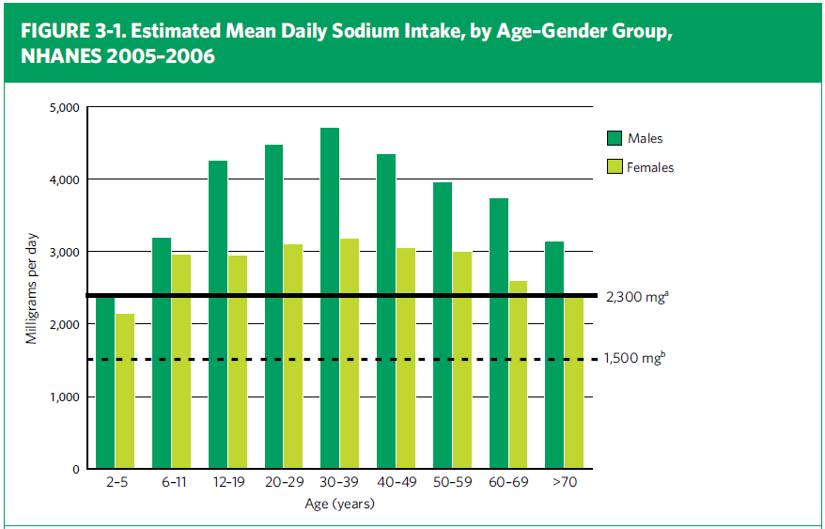
Sodium Intake
Notes:
This chart shows that average intakes of sodium are well above 2300 mg level for all ages under 50, except the very youngest children, and far above the 1500 mg for all age groups, including adults over the age 50 for whom 1500 mg is the recommendation.

Slide 13
Advice to Reduce Sodium Intake
Read the Nutrition Facts label for information on sodium content of foods, and purchase foods low
in sodium
Consume more fresh foods and fewer processed foods high in sodium
Eat more foods prepared at home, where you have more control, and use little or no salt or salty seasonings when cooking and eating foods
When eating at restaurants, ask that salt not be added to your food, and order lower sodium options
if available
Notes:
The document includes specific advice for consumers on how to reduce sodium intake, including the suggestions listed on this slide
And, as noted on another slide, it also calls for a deliberate reduction in the sodium content of foods available in the marketplace.

Slide 14
Chapter 3 Foods and Food Components to Reduce
Fats
Saturated fatty acids—less than 10% of calories
Less than 7% reduces risk of CVD further
Replace with poly- and monounsaturated fatty acids (not with sugar or refined grain)
Trans fats—as low as possible
Cholesterol—less than 300 mg per day
Effect small compared to saturated and trans fats new
Egg yolks—up to 1 per day new
Notes:
The recommendation for saturated fatty acids remains at less than 10% of calories. Also noted is that 7% can further reduce risk of cardiovascular disease. The key recommendation specifically notes that the percentage of calories from saturated fat should be lowered by replacing them with poly- and monounsaturated fatty acids because of the health benefits they convey and also to guard against increasing the intakes of added sugars and refined grains.
Trans fatty acid intake should be as low as possible, and cholesterol should be kept to under 300 mg/day. The effect of dietary cholesterol on blood lipids is reduced when saturated fatty acid intake is low; and the potential negative effects of dietary cholesterol are small compared to those of saturated and trans fatty acids. Furthermore, one egg yolk per day does not increase blood cholesterol levels nor the risk of cardiovascular disease.

Slide 15
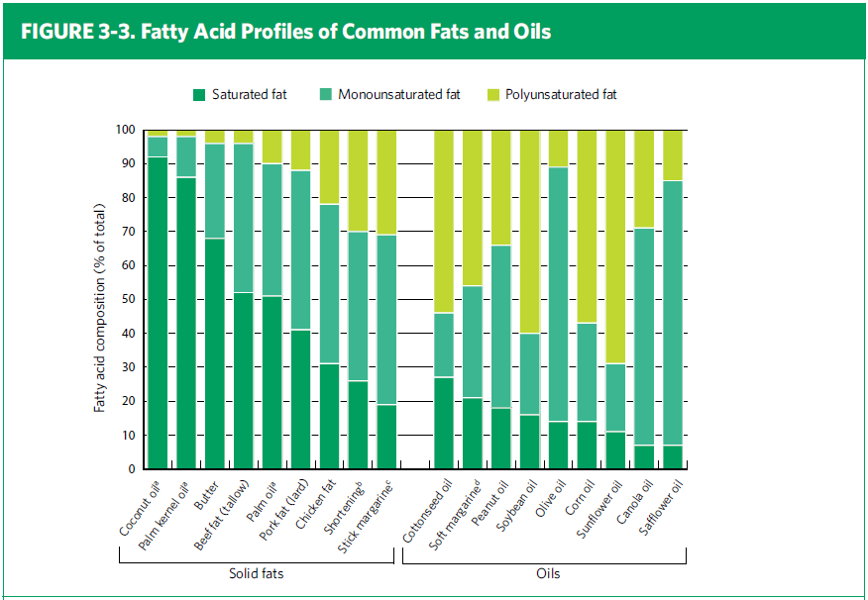
Fatty Acid Profiles of Fats and Oils
Notes:
This slide illustrates how food sources of fats and oils contain the three types of fatty acids in varying proportions . It serves to clarify the rationale for use of the concepts of “solid fats” and “oils.”

Slide 16
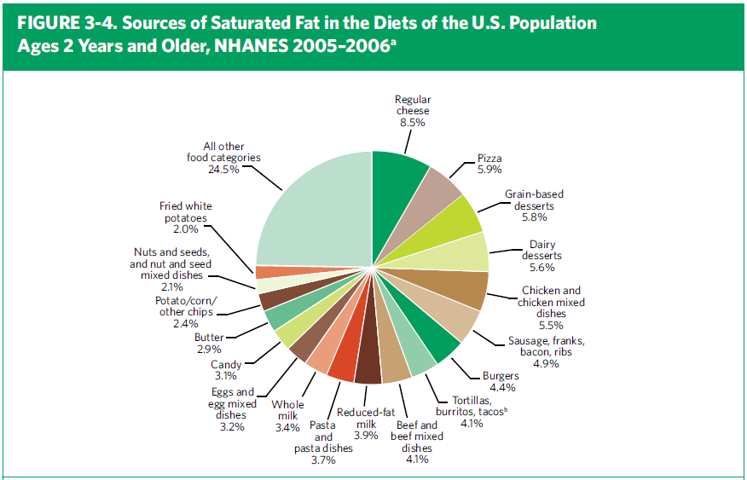
Food Sources of Saturated Fats
Notes:
This chart illustrated the major food sources of saturated fatty acids in the American diet, and illustrates why the Guidelines emphasize fat-free and low fat dairy products and lean meats and poultry.

Slide 17
Chapter 3 Foods and Food Components to Reduce
Calories from solid fats and added sugars new
Reduce intake of calories from solid fats and
added sugars (SoFAS)
SoFAS provide 35% of calories
Do not contribute nutrients
Only 5 to 15% of calories from SoFAS can be accommodated in healthy diets
Notes:
A new key recommendation is to reduce calories from solid fats and added sugars.
These two food components together provide over a third of the calories in the diets of Americans, while contributing very little in the way of nutrients. Intake of these food components replaces nutrient-dense foods, and makes it very difficult to achieve recommended nutrient levels. In fact, only 5 to 15% of calories from SoFAS can be accommodated in diets that are nutritionally adequate and within calorie limits, so a dramatic reduction is called for.

Slide 18
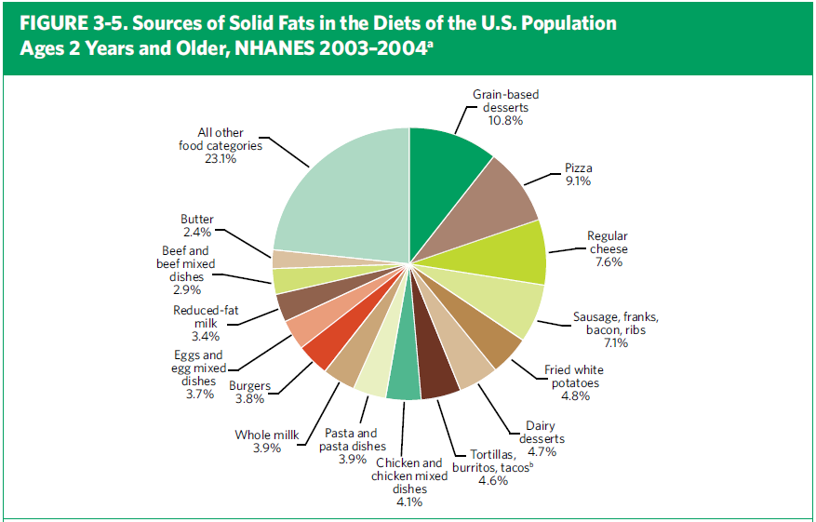
Food Sources of Solid Fats
Notes:
This chart shows the sources of solid fats in the diets of the US population.

Slide 19
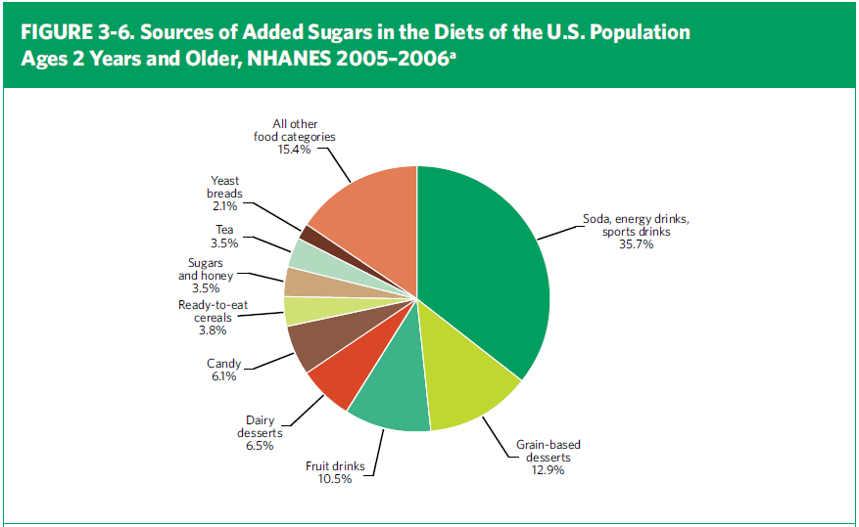
Food Sources of Added Sugars
Notes:
This chart shows the sources of added sugars in diets of the US population. It highlights the contribution of sodas and similar calorically-sweetened beverages as the major source of added sugars in the American diet.

Slide 20
Chapter 3 Foods and Food Components to Reduce
Refined grains
Limit consumption of refined grains, especially those that contain solid fats, added sugars, and sodium new
Enriched refined grain products provide some vitamins and minerals, but not the fiber provided by whole grains
Replace refined grains with whole grains
Notes:
Another new key recommendation is to limit refined grains, especially those that contain solid fats, added sugars, and/or sodium.

Slide 21
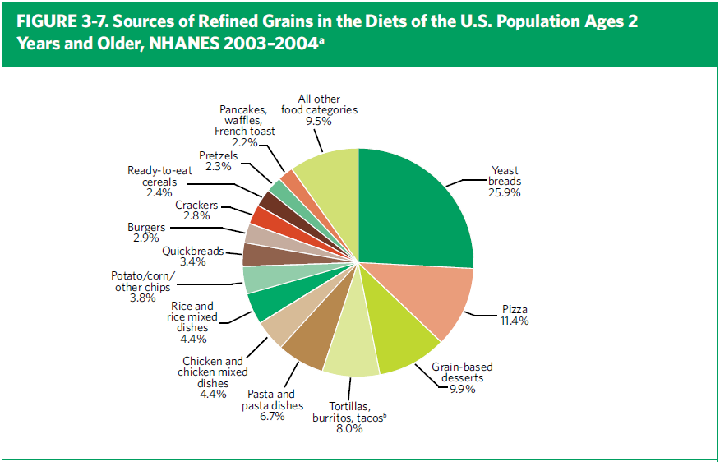
Food Sources of Refined Grains
Notes:
This chart shows the sources of refined grains in the diets of the US population.
It illustrates the rationale for the recommendation to substitute whole grain products for refined grain products. Over ¼ of all refined grains consumed are from yeast breads, rolls, and bagels. These items and many other foods on the chart have whole grain counterparts in the marketplace that can readily be selected by consumers.

Slide 22
Chapter 3 Foods and Food Components to Reduce
Alcohol
If alcohol is consumed, consume in moderation
For men, up to 2 drinks per day
For women, up to 1 drink per day
Specific guidance for breast-feeding women new
Circumstances in which people should not drink alcohol listed
Notes:
The guideline for alcohol consumption remains unchanged from 2005. The definition of moderate alcohol consumption used in the recommendation is up to two drinks in any singe day for men, and up to one drink in a day for women.
[Note: This is the only instance in the Guidelines where the amount specified “per day” refers to an amount consumed on any single day. All other dietary recommendations are for daily averages over time.]
New is the guidance on how a breast-feeding woman can occasionally consume an alcoholic beverage without exposing her infant to alcohol. The DGAC pursued the evidence on this topic because of the awareness that some women stop breast-feeding altogether because they want to have an occasional glass of wine.
New to the long list of circumstances in which people should not drink at all is swimming.

Slide 23
Alcohol—Definitions
Notes:
The Guidelines provides additional information on alcohol through definitions in sidebar boxes. They identify the amounts that count as “one drink”; and “moderate,” “heavy,” and “binge drinking” are defined.

Slide 24
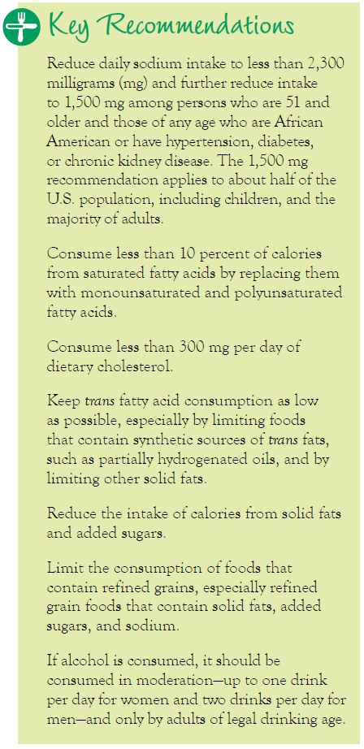
Chapter 3 Foods and Food Components to Reduce
Notes:
Chapter 3 Key Recommendations

Slide 25
Chapter 4 Foods and Nutrients to Increase
While staying within calorie needs, increase intake of
Vegetables
Fruits
Whole grains
Milk
Seafood, in place of some meat/poultry new
Oils
Nutrients of public health concern
Potassium
Fiber
Calcium
Vitamin D
Notes:
To improve their diets, Americans need to eat more the following food groups in nutrient-dense forms: vegetables; fruits; whole grains; and milk.
The total amount of Protein Foods Americans eat is adequate on average; but within that food group, seafood should be consumed in greater amounts, and meat and poultry in smaller amounts. Oils should be used to replace solid fats when possible.
Also discussed in this chapter are the four nutrients the DGAC concluded were of public health concern: potassium, dietary fiber, calcium, and vitamin D. The designation of vitamin D as a nutrient of public health concern is based on the DGAC Report, not on the Institute of Medicine’s conclusions in the new Dietary Reference Intakes report. The new Recommended Dietary Allowances for vitamin D are included in an appendix of the DGAs, 2010. They were set under the assumption of minimal sun exposure.

Slide 26
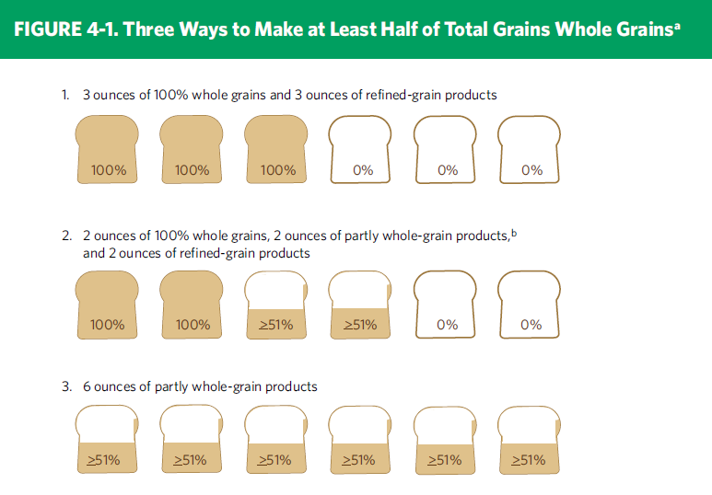
Whole Grain Guidance
Notes:
This slide shows an example of a explanatory graphic from the Guidelines. The actual Guideline for whole grains is “consume at least half of your grains as whole grains,” and this figure shows 3 different ways of how someone could choose to make half of their total grain intake whole grain, using bread as an example.

Slide 27
Chapter 4 Foods and Nutrients to Increase
Notes:
Chapter 4 Key Recommendations for everyone age 2 and older

Slide 28
Chapter 4 Foods and Nutrients to Increase
Notes:
These are key recommendations for specific population groups from chapter 4.
Substantial numbers of women who are capable of becoming pregnant, including adolescent girls, are deficient in iron, so they have a specific recommendation for iron as well as for folic acid.
Pregnant women also have an iron recommendation and one for 8-12 oz of seafood per week. The DGAC carefully considered the risks of contaminants in seafood and the benefits of seafood and the important fatty acids it contributes to the diets of pregnant women. Specific guidance is given on limiting white tuna to 6 oz per week and avoiding the four types of fish high in methyl mercury.
Individuals ages 50 and older are advised to consume vitamin B12 in its crystalline form, available in fortified foods and supplements, to assure absorption.

Slide 29
Chapter 5 new Building Healthy Eating Patterns
Research on overall eating patterns
Considerable evidence for health outcomes from DASH and traditional Mediterranean eating patterns
Some evidence for vegetarian
Common elements of healthy eating patterns identified
To promote health, follow USDA Food Patterns or DASH Eating Plan
Similar to each other and to the healthful eating patterns identified in the research
Follow food safety recommendations
Notes:
Until recently, evidence was insufficient to document the impact of overall diets and eating patterns on health outcomes. The DGAC conducted a (non-systematic) literature review and found considerable evidence for positive health outcomes from DASH and traditional Mediterranean eating patterns and some for vegetarian diets.
The Guidelines identify the dietary patterns described by the USDA Food Patterns and the DASH Eating Plan as healthy eating patterns. The USDA food patterns also include lacto-ovo vegetarian and vegan adaptations.
For good health, it is also necessary to follow the food safety recommendations found in Chapter 5 and in more detail in an appendix to the policy document.

Slide 30
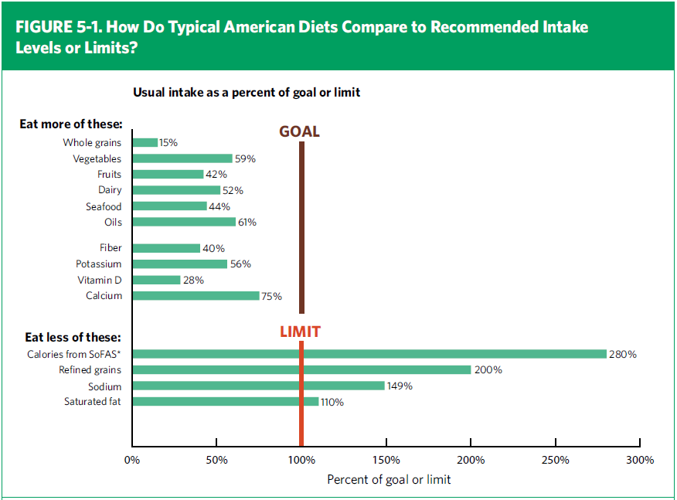
Comparison of Consumption to Recommendations
Notes:
This chart shows how the average American diet compares to recommendations found in the 2010 Dietary Guidelines. Whole grains, vegetables, fruits, dairy products, seafood, and oils are consumed below recommended amounts. Nutrients of concern are fiber, potassium, calcium, and vitamin D. Note that the intake shown for vitamin D only includes food sources, not supplements or vitamin D manufactured in response to sun exposure.
The excessive amounts consumed of solid fats and added sugars, refined grains, and sodium are clearly shown in comparison to recommended limits.

Slide 31
USDA Food Patterns Changes for 2010 Dietary Guidelines
Vegetarian adaptations
Lacto-ovo and vegan
Two food groups renamed
“Meat & Beans” became “Protein Foods”
“Milk” became “Dairy Products”
Fortified soy milk included
Milk for 4- to 8-year-olds increased by ½ cup per day
At least 8 oz per week of seafood for adults
3 to 6 oz for children
Vegetable subgroups
Amounts revised
“Orange” revised to “Red and Orange”
Notes:
Based on work done in concert with the DGAC, the USDA Food Patterns were updated and are published in the Policy Document along with the DASH Eating Plan. Updates to the USDA Food Patterns include:
Lacto-ovo and vegan versions are provided. The vegan version relies on fortified foods to meet calcium and vitamin B-12 recommendations.
Based on consumer research, two food groups were renamed: the former Meat and Beans group is now called the Protein Foods group, and the former Milk group is now called the Dairy group. Fortified soy beverages are now considered part of the dairy group.
Because of the new RDAs for calcium, the amount of milk for 4- to 8-year-olds was increased from 2 to 2½ cups per day.
Consistent with the new recommendation for seafood, the amount of seafood in all patterns for adults was increased to at least 8 ounces per week. The total amount of protein foods remained constant, and the amounts of meat and poultry were decreased to accommodate the seafood recommendation.
Vegetable subgroups were realigned. The biggest change was moving tomatoes to the new “red and orange” subgroup. Recommended intake amounts were kept within the “best practices” amounts—that is, they do not exceed the amount the top 5% of the population consumes.

Slide 32
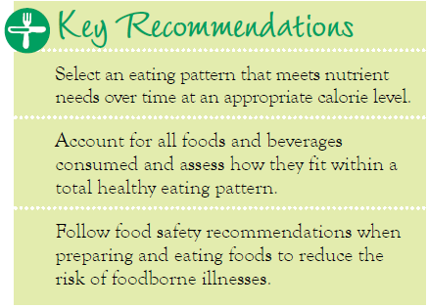
Chapter 5 Building Healthy Eating Patterns
Notes:
Chapter 5 Key Recommendations

Slide 33
Chapter 6 new Helping Americans Make Healthy Choices
Current food and physical activity environment is influential—for better and for worse
All elements of society, have a role
Individuals and families
Communities
Business and industry
All levels of government
Work together to improve the Nation’s nutrition and physical activity
Notes:
Major points made in Chapter 6 include:
The current food and physical activity environment is influential in the nutrition and activity choices that people make—for better and, unfortunately, more often for worse.
All elements of society have a positive and productive role to play in the movement to make America healthy: individuals and families, communities, business and industry, and all levels of government.
The chapter suggests a number of ways these players can work together to improve the Nation’s nutrition and physical activity.

Slide 34
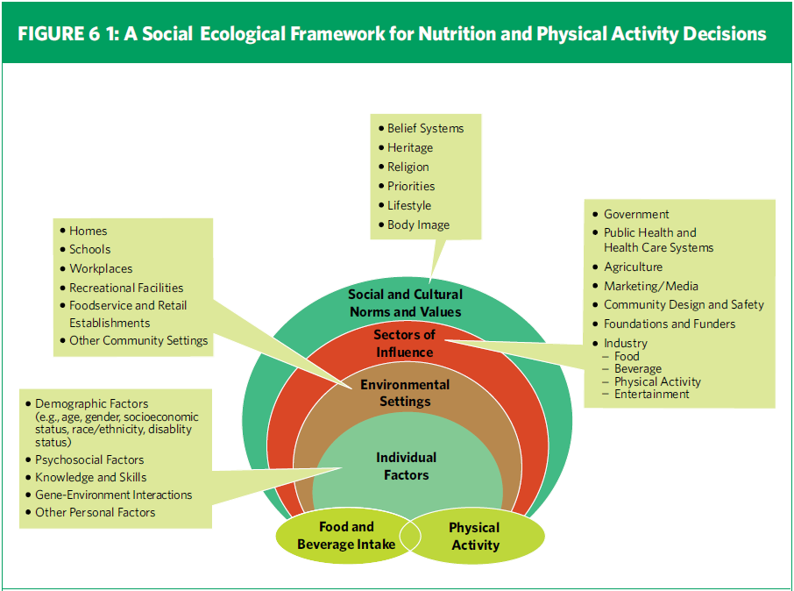
Socio-ecological Framework
Adapted from Story M et al., Annu Rev Public Health 2008;29:253-272
Notes:
This figure from Chapter 6 illustrates the many factors that influence decisions about food choices and physical activity.

Slide 35
Summary
Dietary Guidelines for Americans, 2010
Evidence-based nutritional guidance
Promote health
Reduce the risk of chronic diseases
Reduce the prevalence of overweight and obesity
Integrated set of advice for overall eating pattern
Consumer-friendly advice and tools coming
Notes:
The 2010 Dietary Guidelines for Americans is the federal government's evidence-based nutritional guidance to promote health, reduce the risk of chronic diseases, and reduce the prevalence of overweight and obesity through improved nutrition and physical activity. The recommendations are intended to be an integrated set of advice to achieve an overall healthy eating pattern. To get the full benefit, the Dietary Guidelines recommendations should be carried out in their entirety. More consumer-friendly advice and tools will be released in the coming months.

